Slide 1


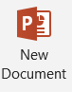
Journey PPT
Journey ppt
Foundational Training – Week 3
(4th Sep 2023- 8th Sep 2023)

Slide 2
Monday
Azure Data Storage, benefits and comparison to on-premise storage
Create a storage account
Azure Data Lake Storage, Big Data with ADLS

Slide 3
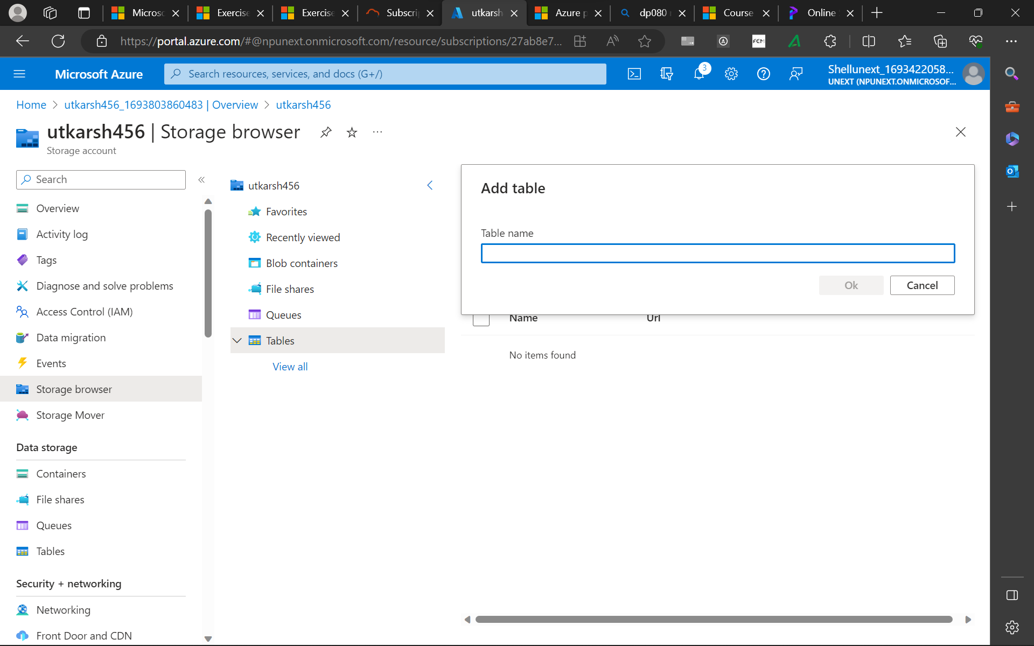
Monday
Azure Data Storage, benefits and comparison to on-premise storage
Create a storage account
Azure Data Lake Storage, Big Data with ADLS

Slide 4
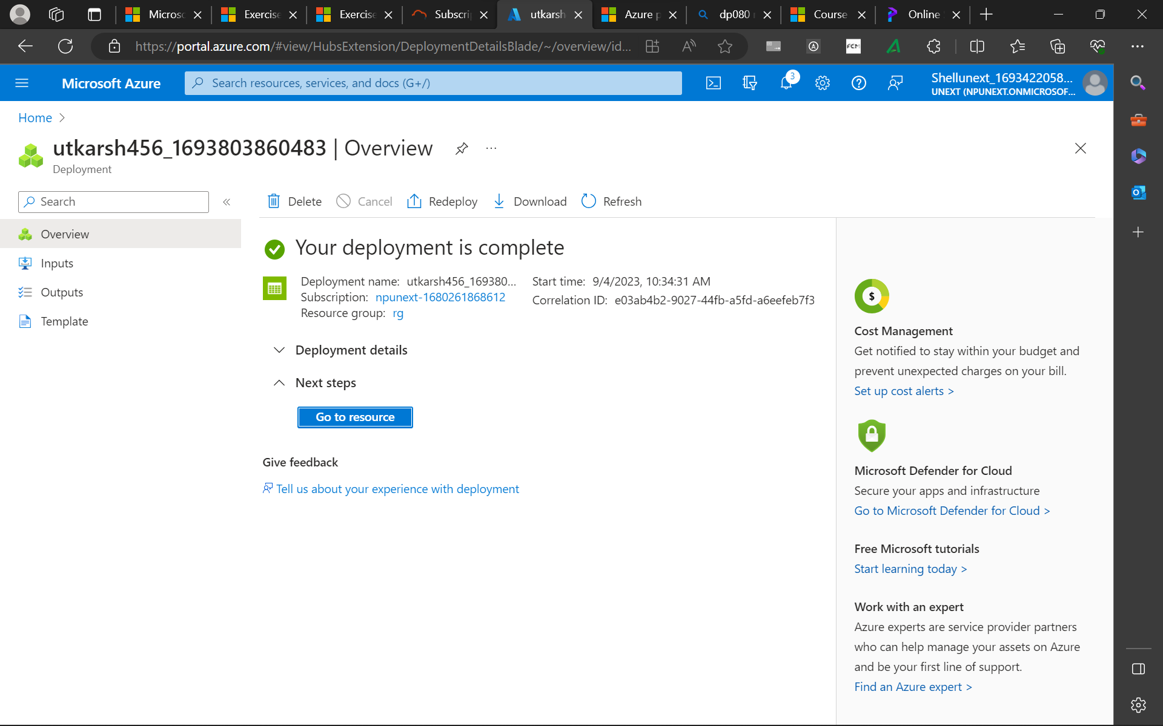
Azure Data Storage, benefits and comparison to on-premise storage
Create a storage account
Azure Data Lake Storage, Big Data with ADLS

Slide 5
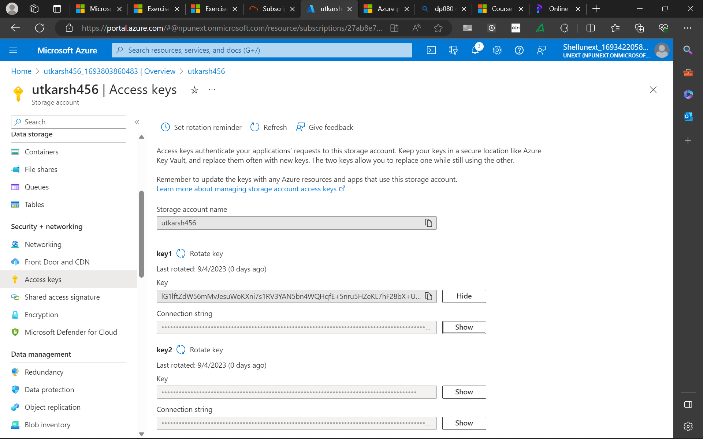
Azure Data Storage, benefits and comparison to on-premise storage
Create a storage account
Azure Data Lake Storage, Big Data with ADLS

Slide 6
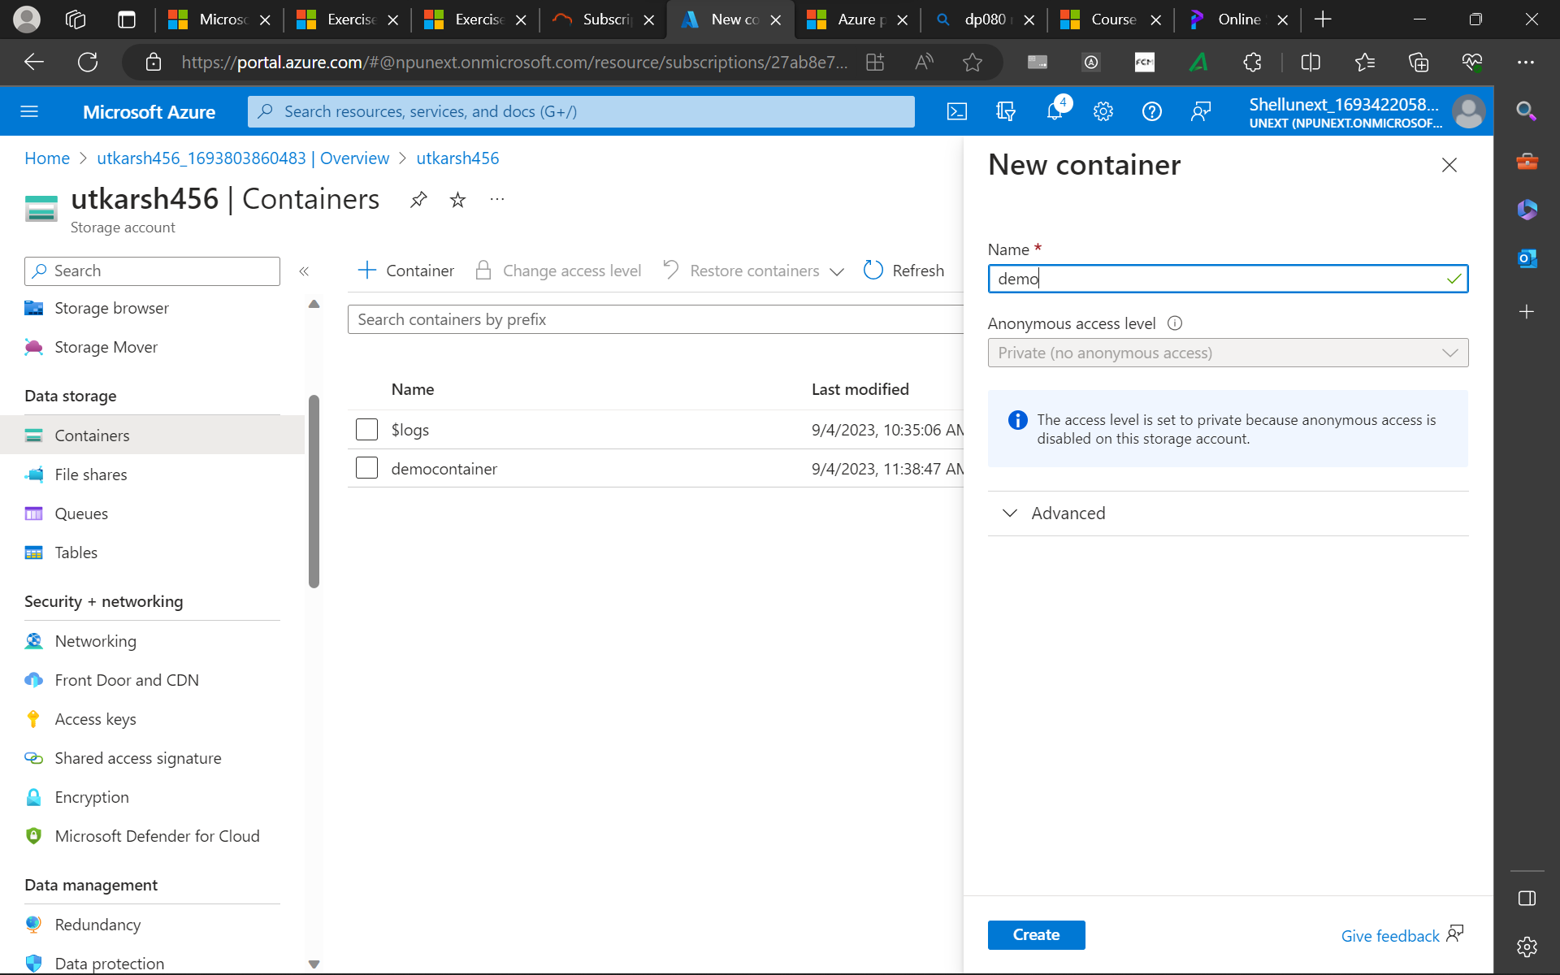
Azure Data Storage, benefits and comparison to on-premise storage
Create a storage account
Azure Data Lake Storage, Big Data with ADLS

Slide 7
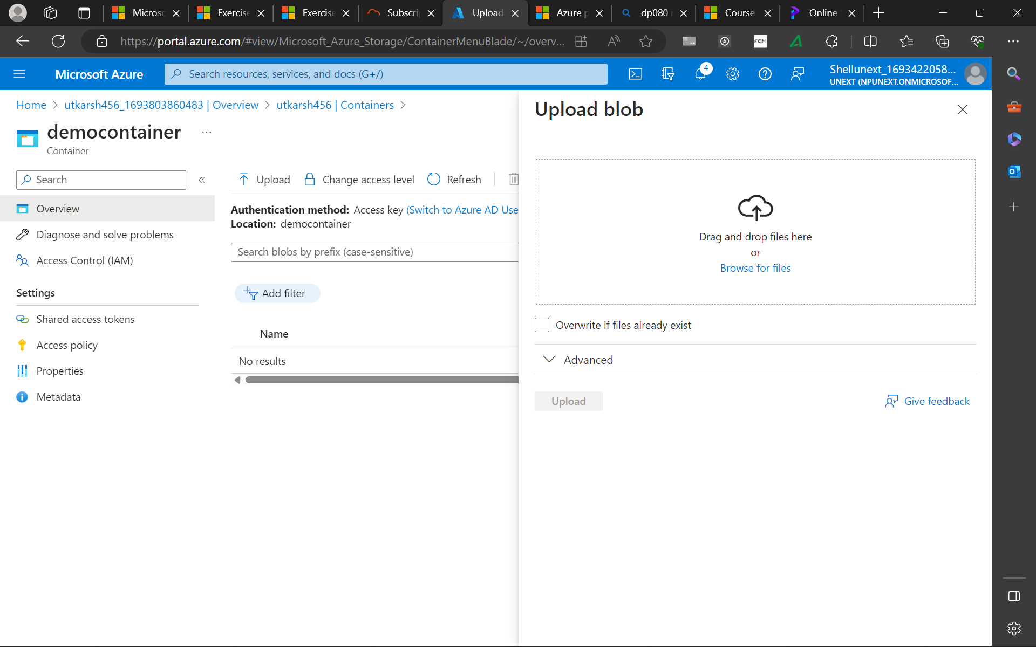
Azure Data Storage, benefits and comparison to on-premise storage
Create a storage account
Azure Data Lake Storage, Big Data with ADLS

Slide 8
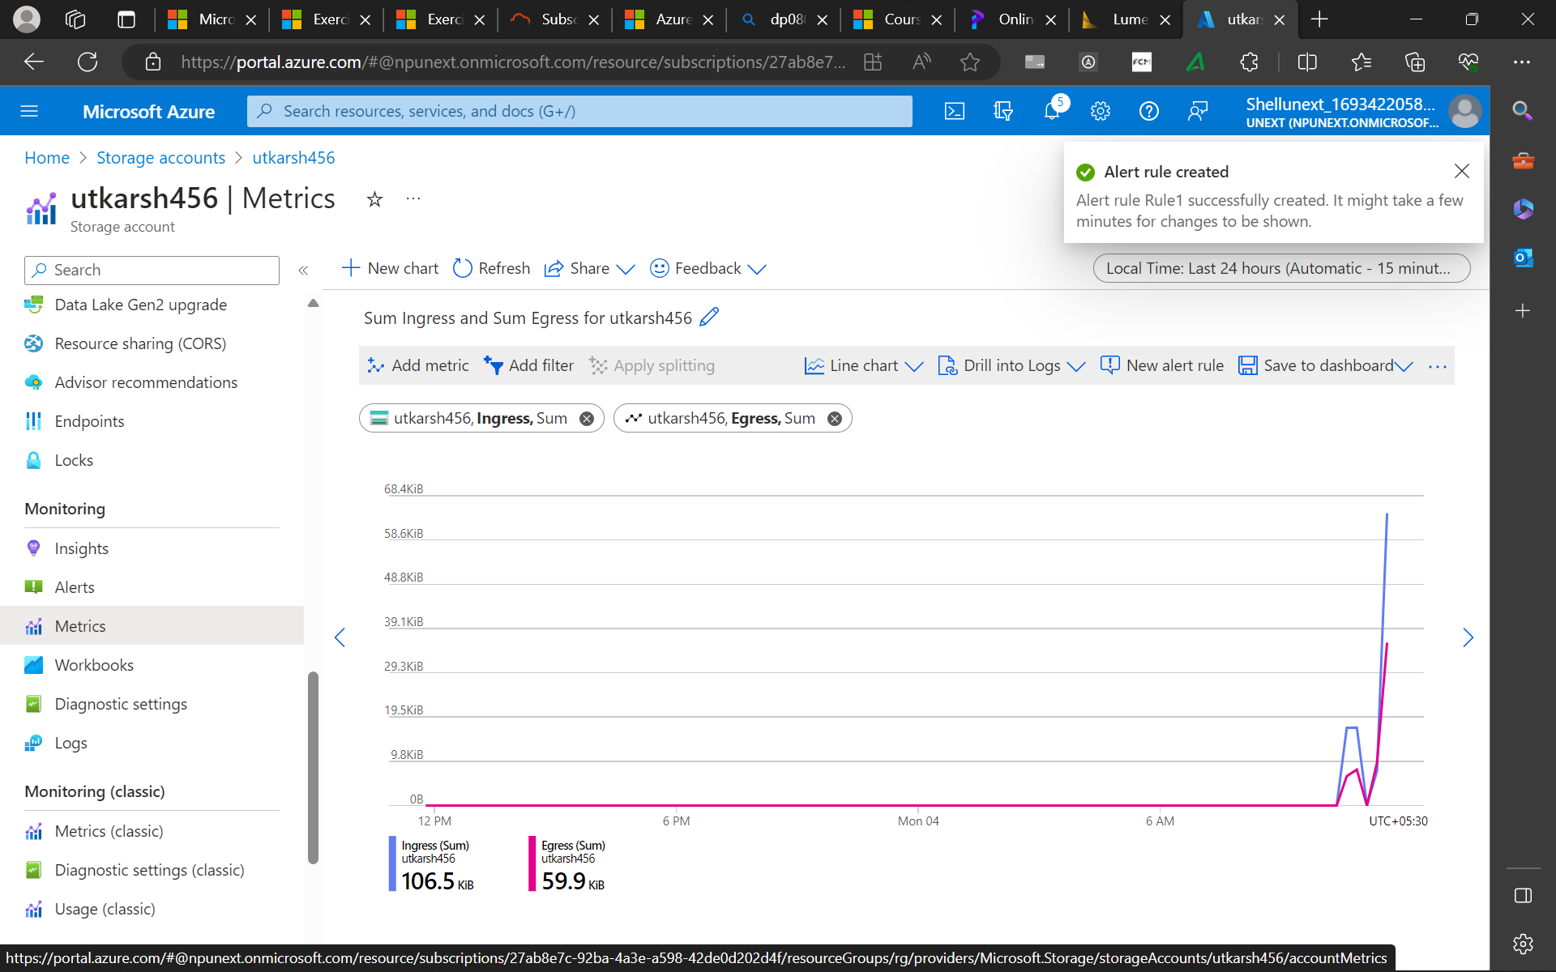
Azure Data Storage, benefits and comparison to on-premise storage
Create a storage account
Azure Data Lake Storage, Big Data with ADLS

Slide 9
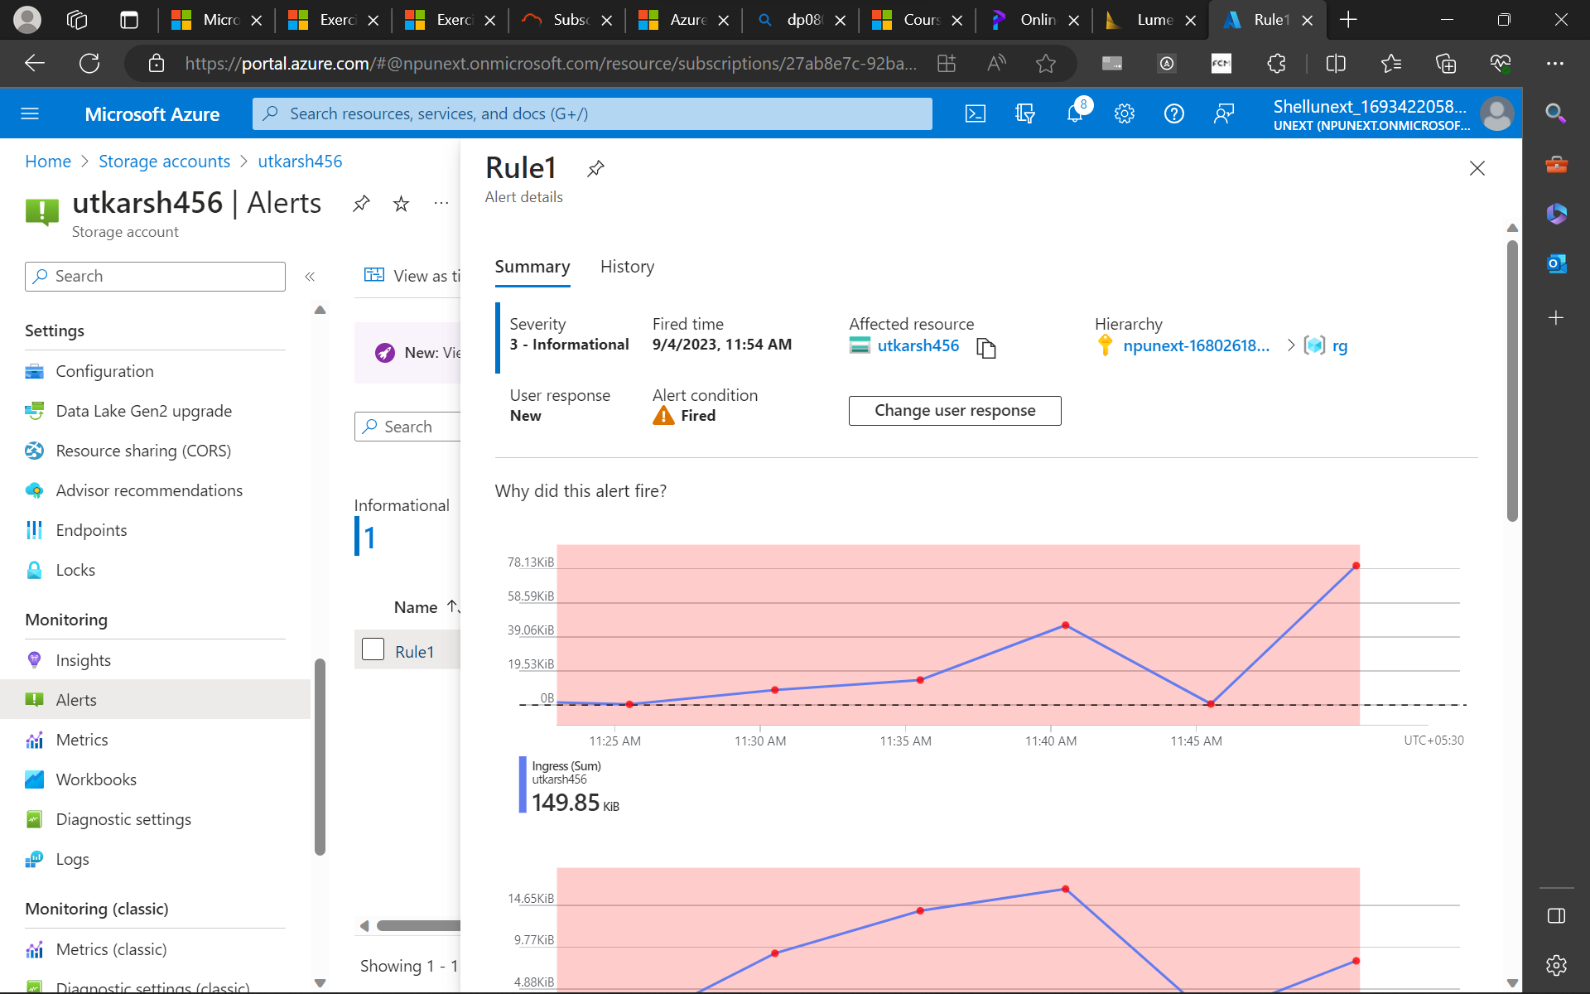
Azure Data Storage, benefits and comparison to on-premise storage
Create a storage account
Azure Data Lake Storage, Big Data with ADLS

Slide 10
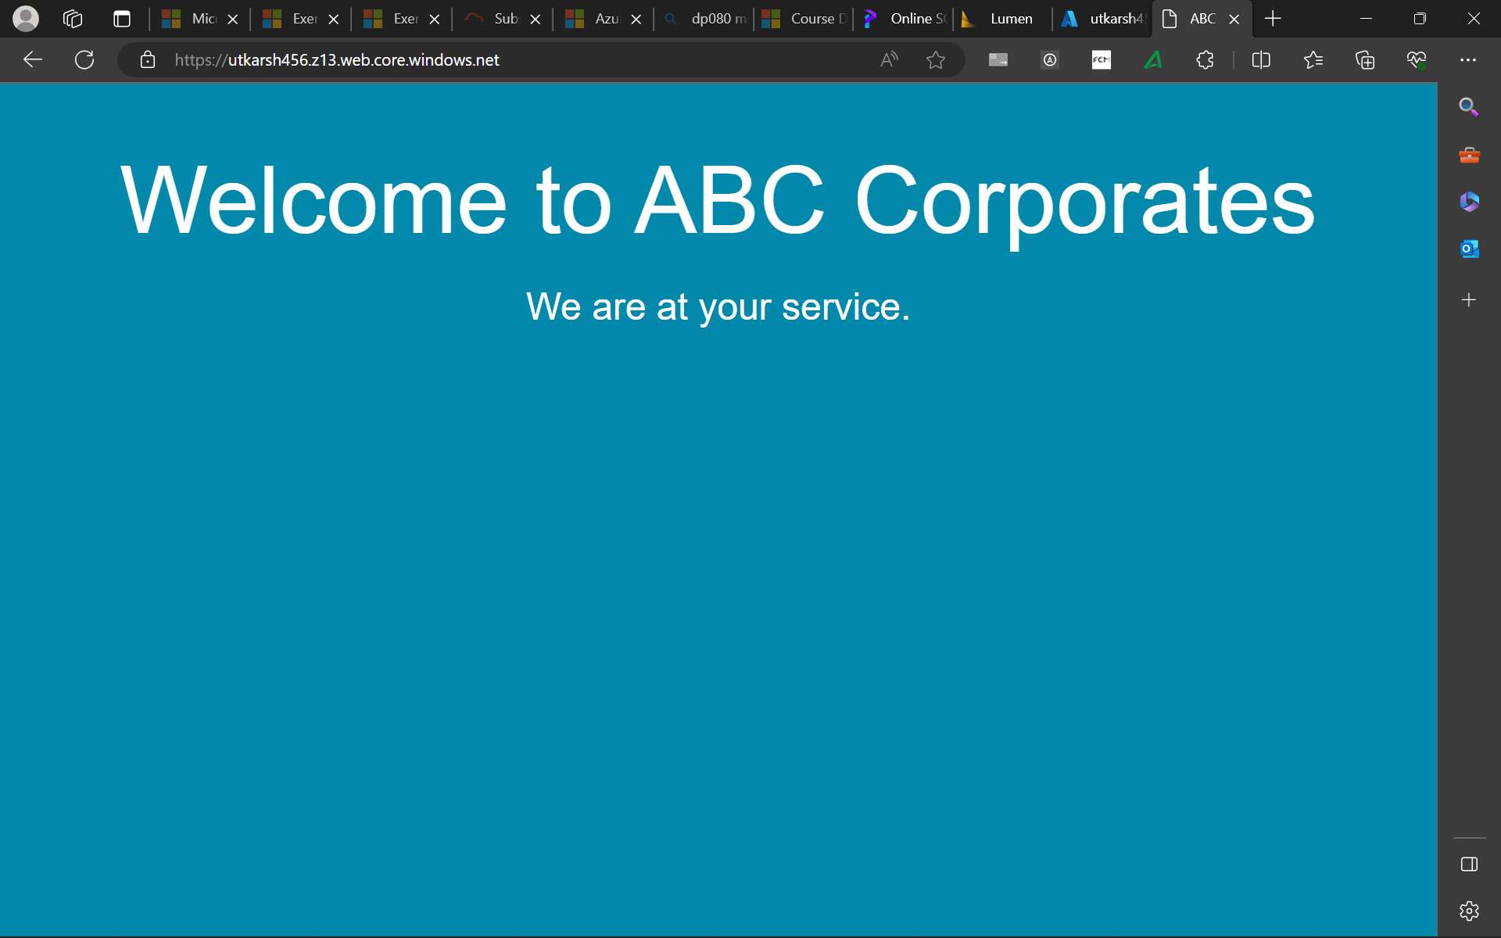
Azure Data Storage, benefits and comparison to on-premise storage
Create a storage account
Azure Data Lake Storage, Big Data with ADLS

Slide 11
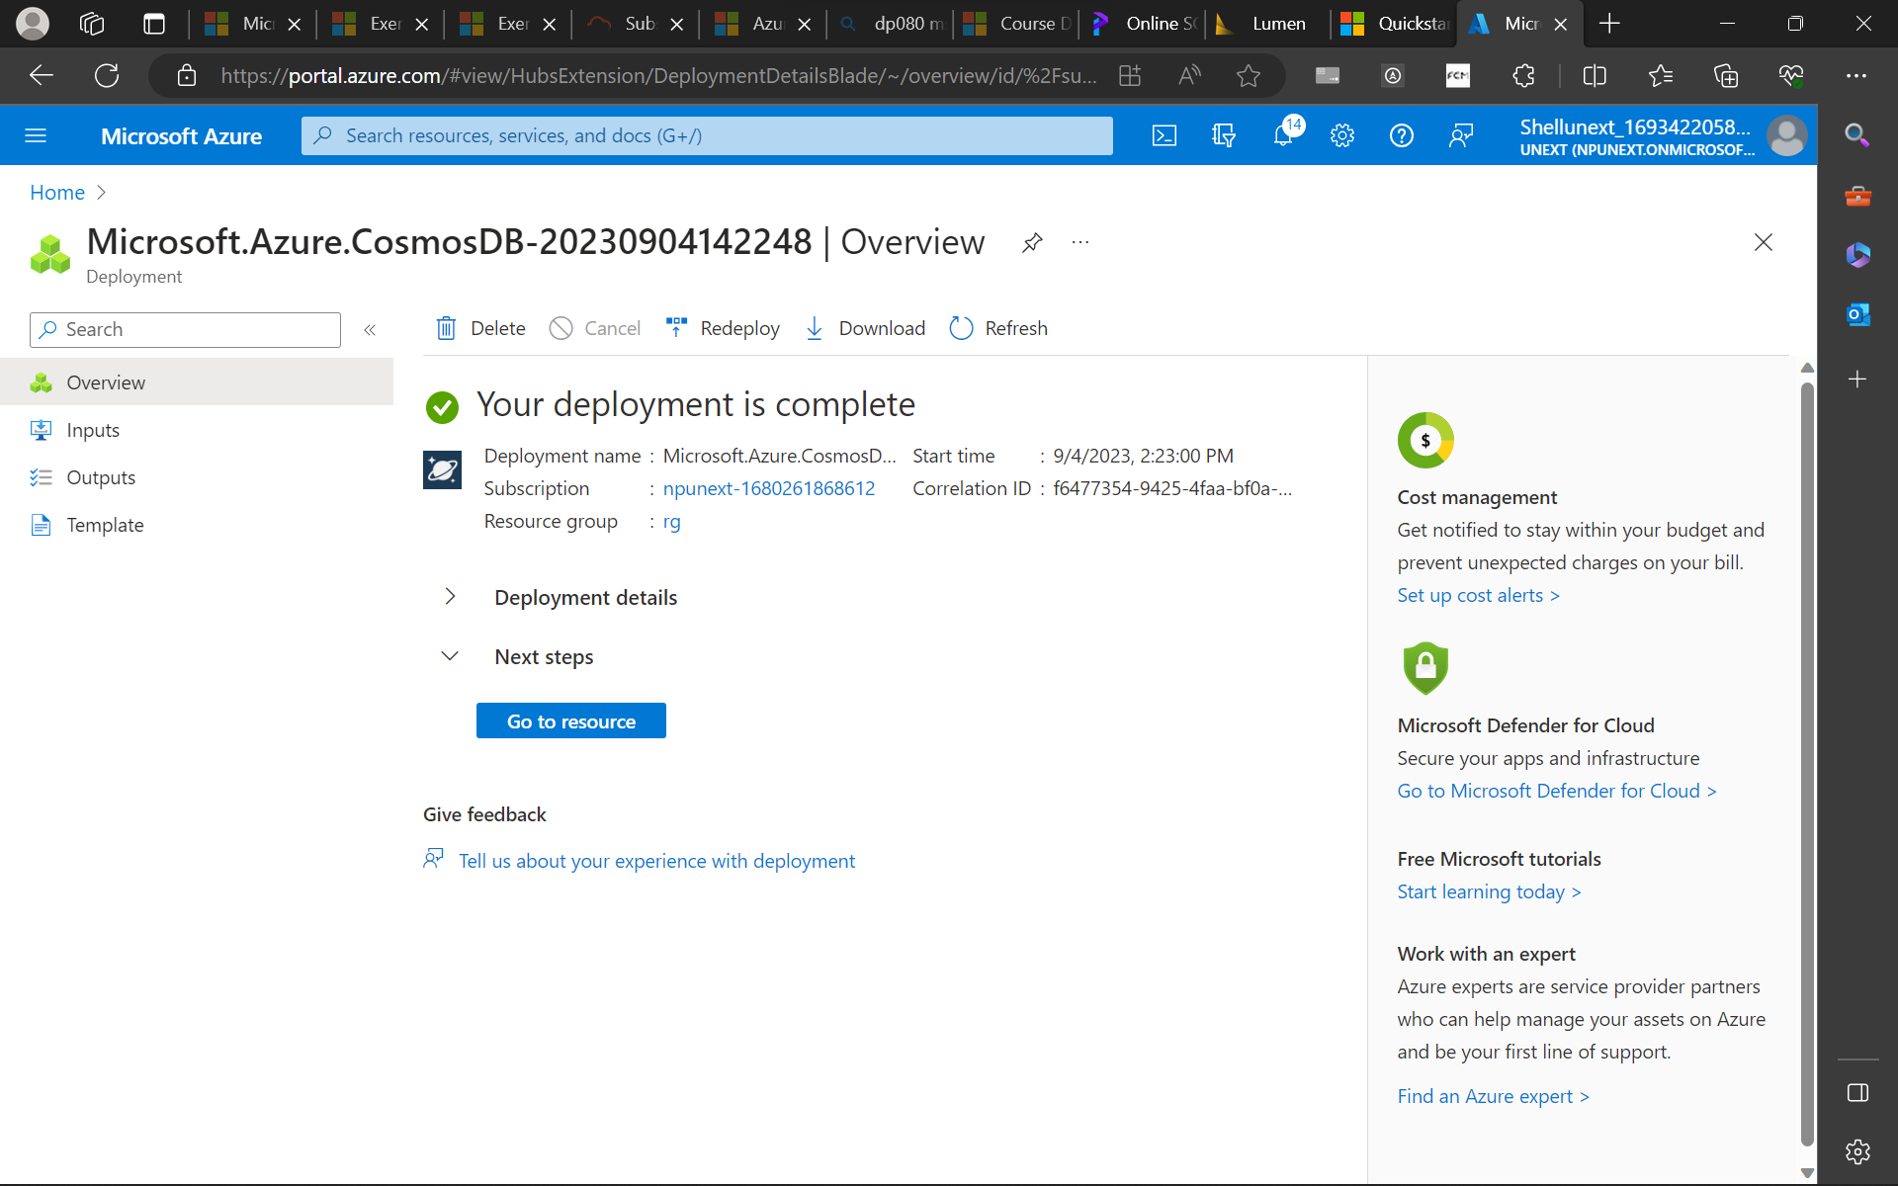
Azure Data Storage, benefits and comparison to on-premise storage
Create a storage account
Azure Data Lake Storage, Big Data with ADLS

Slide 12
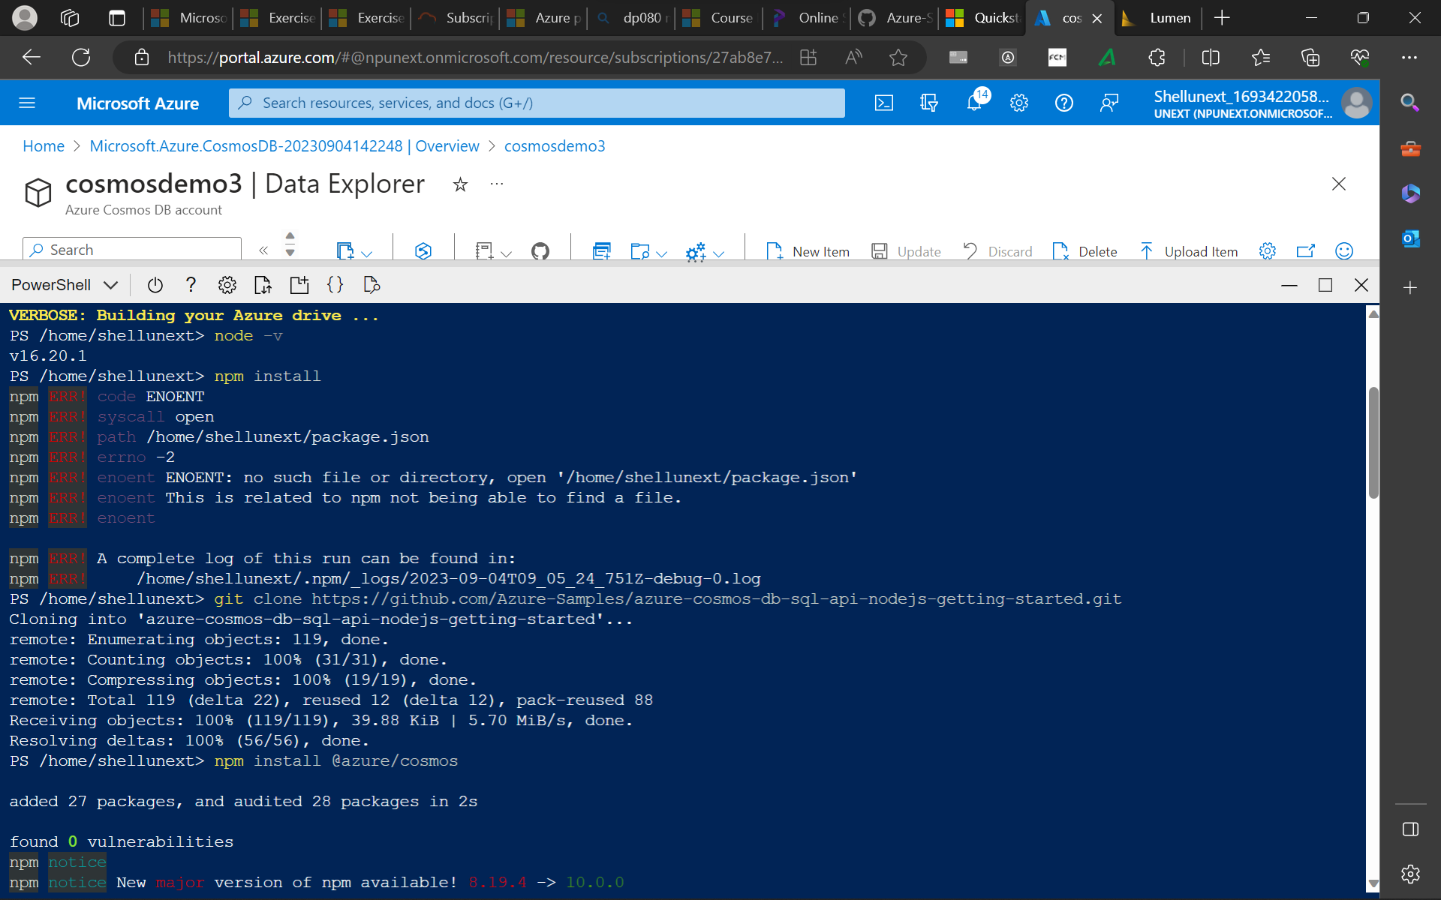

Slide 13
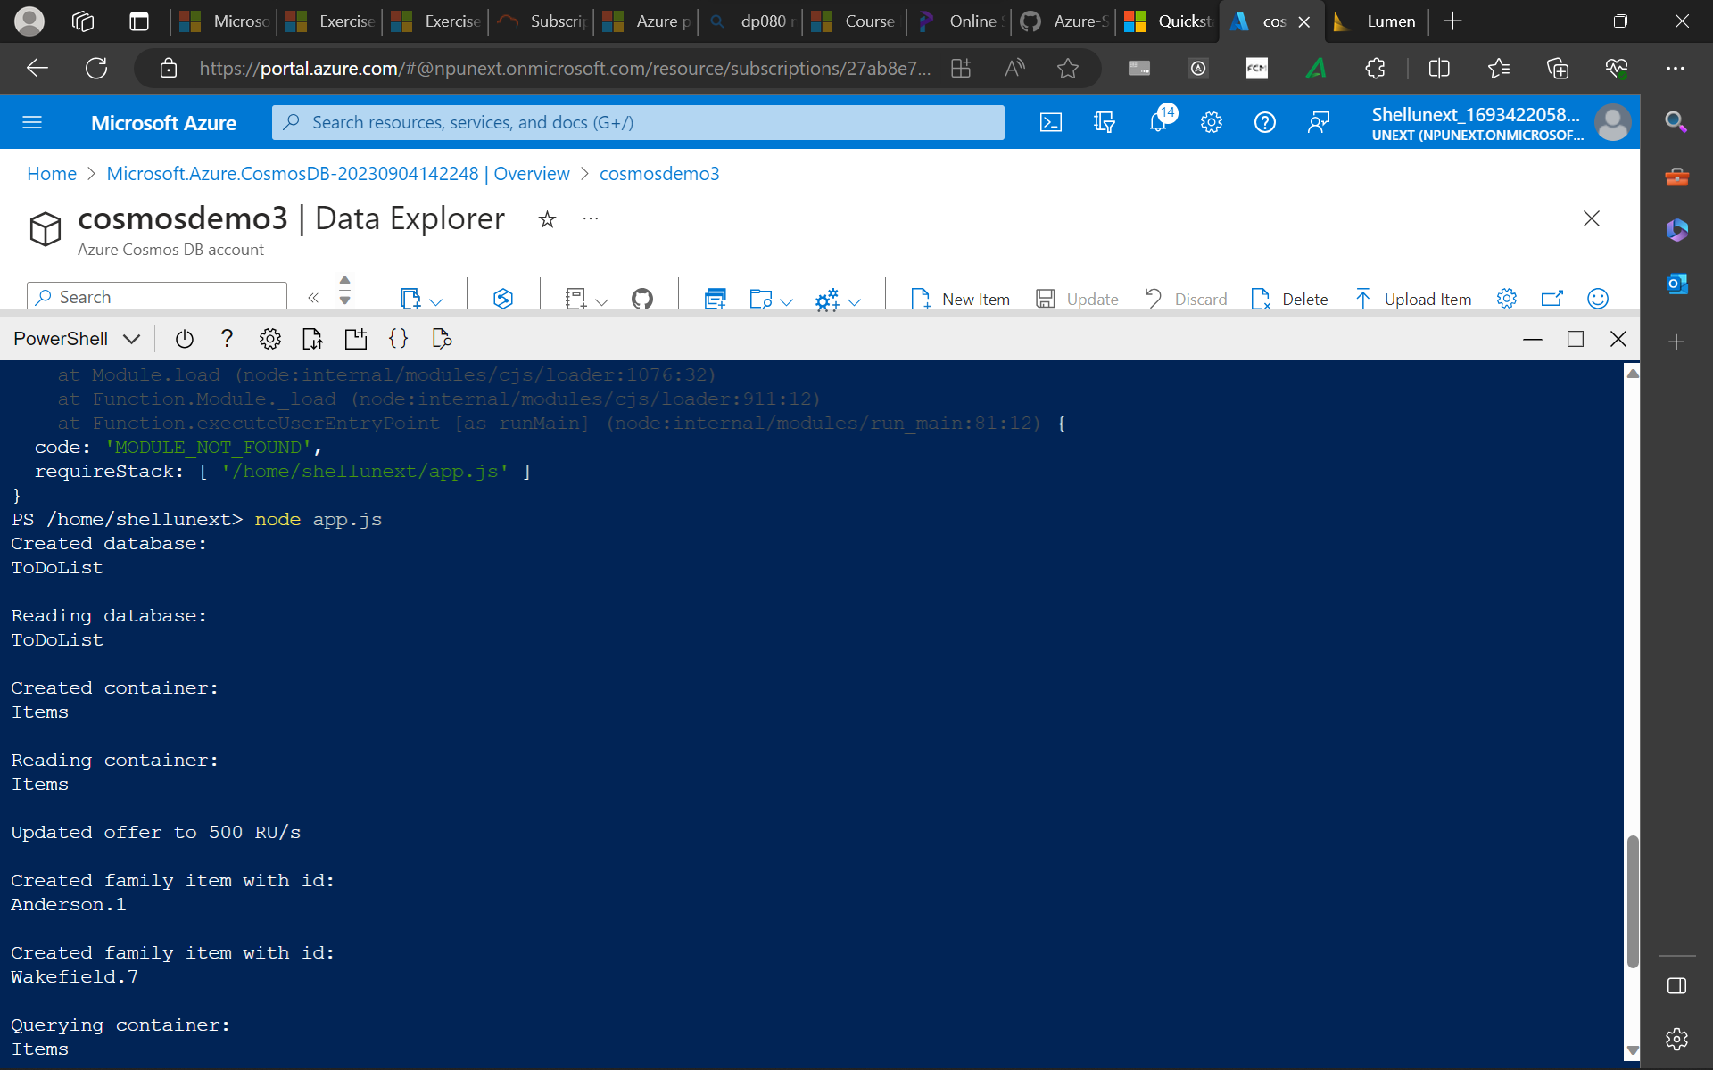

Slide 14
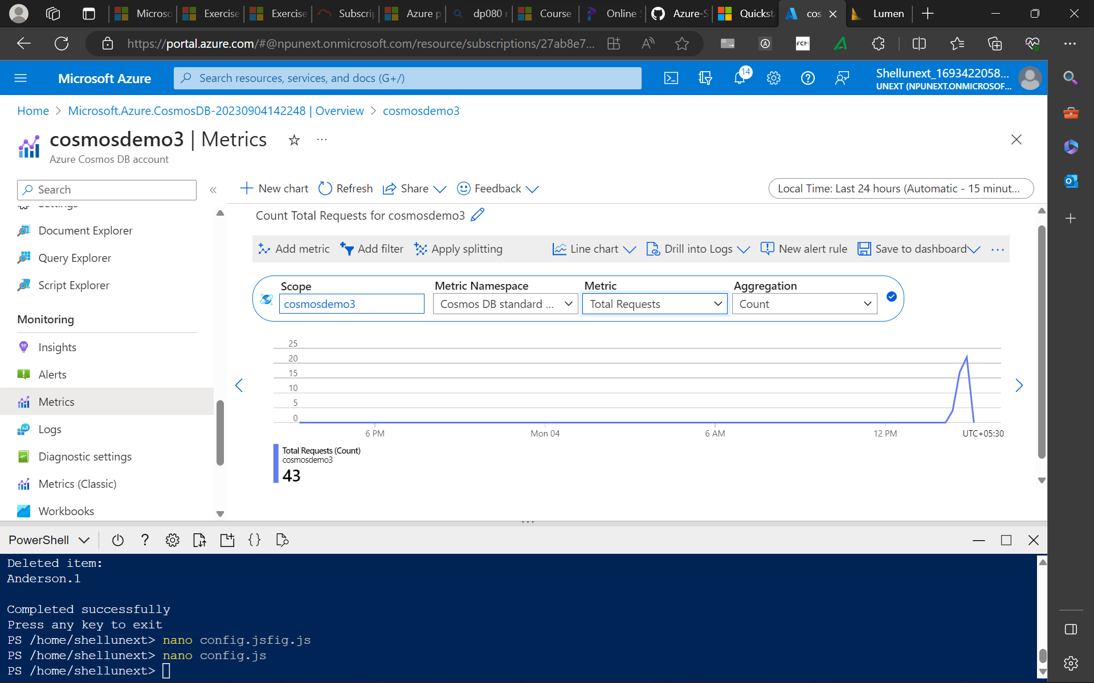

Slide 15
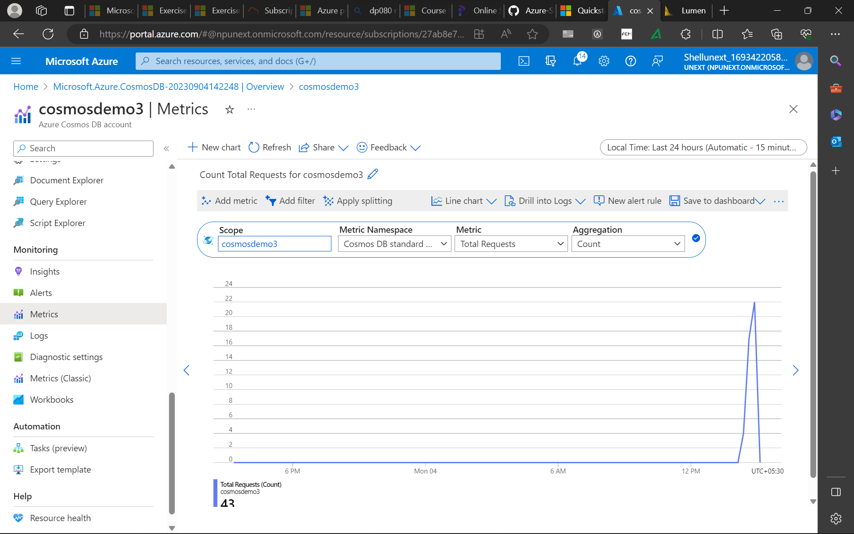

Slide 16
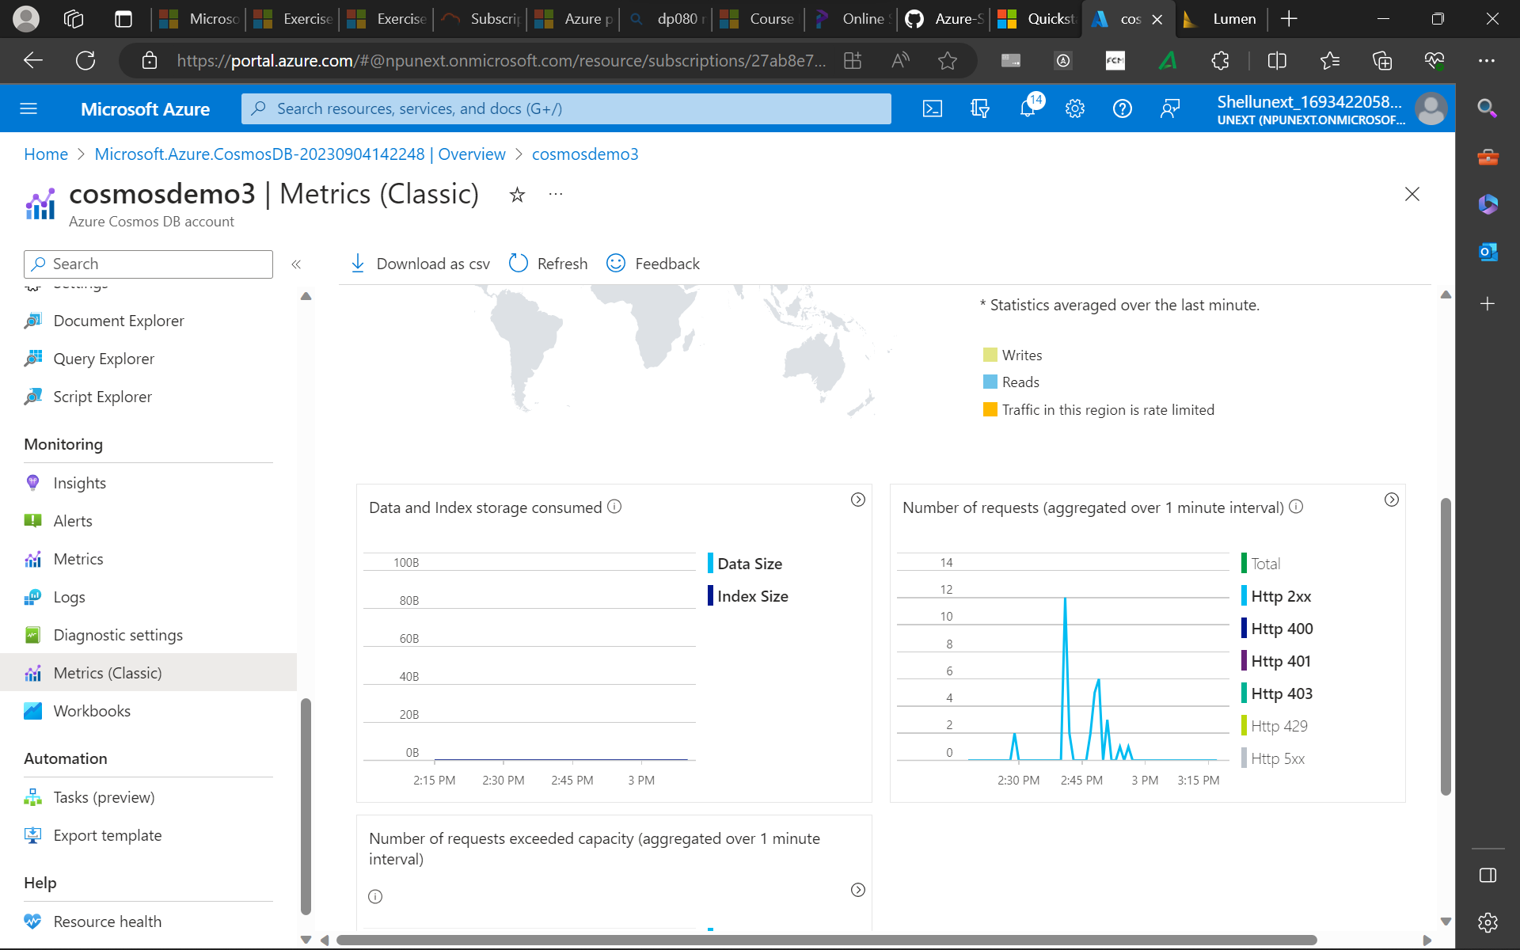

Slide 17
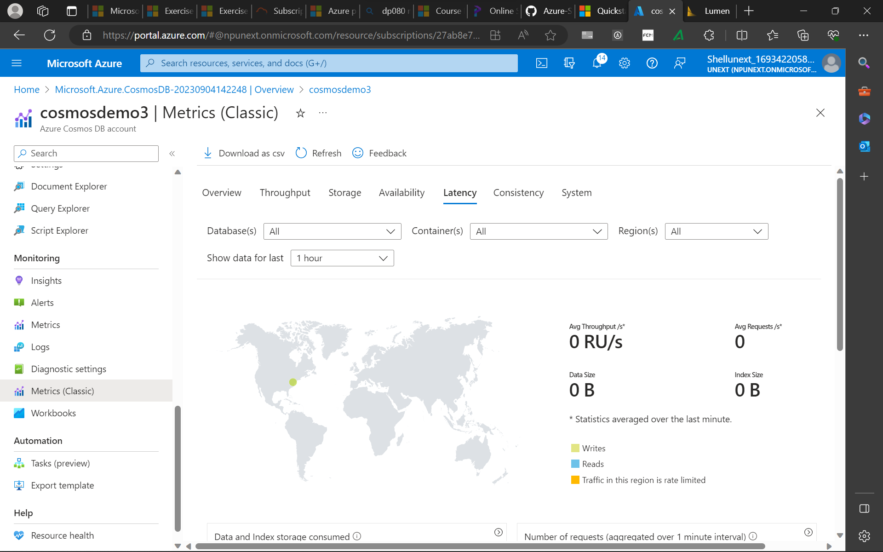

Slide 18
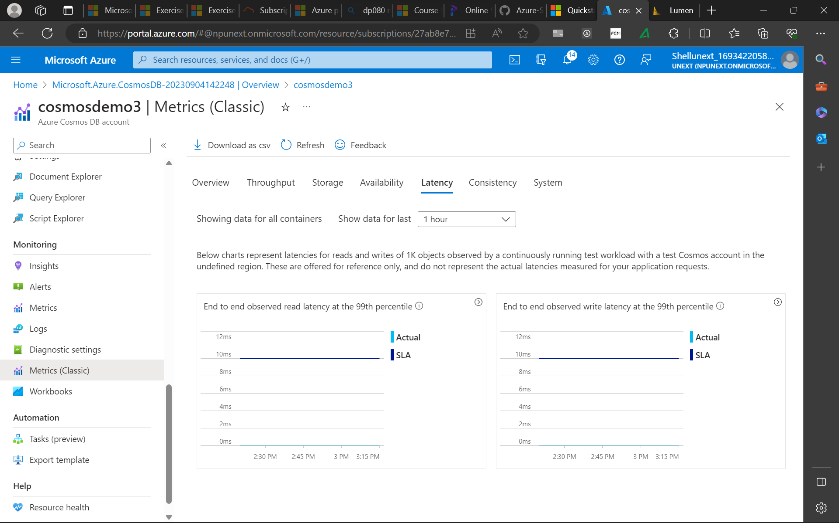

Slide 19
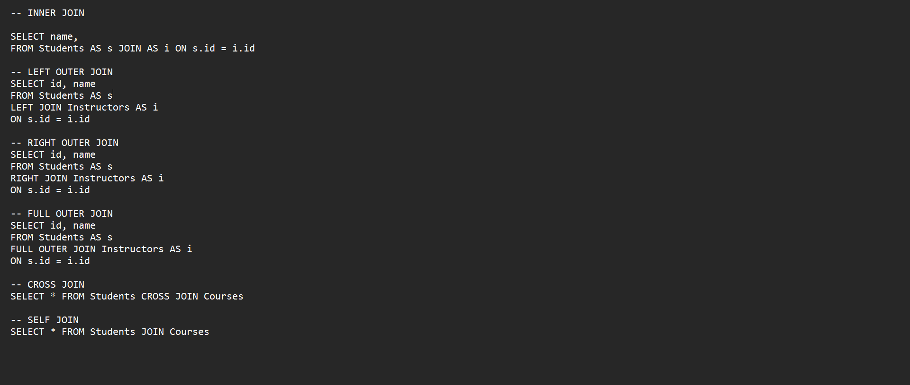

Slide 20
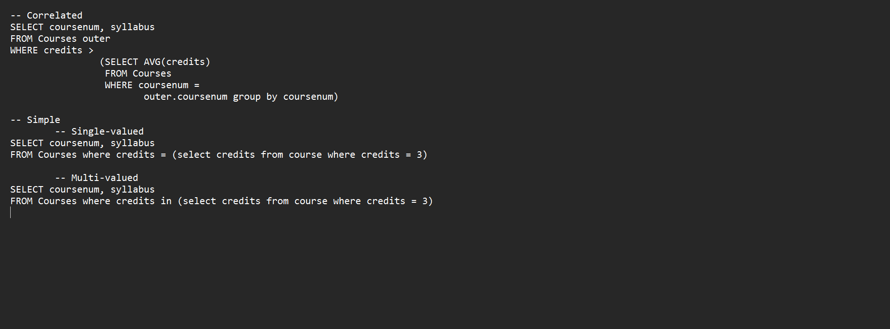

Slide 21
Tuesday
ADLS continued
Azure Data Factory, ETL vs ELT
ADF components: Linked services, Data set, Activity, Pipeline

Slide 22
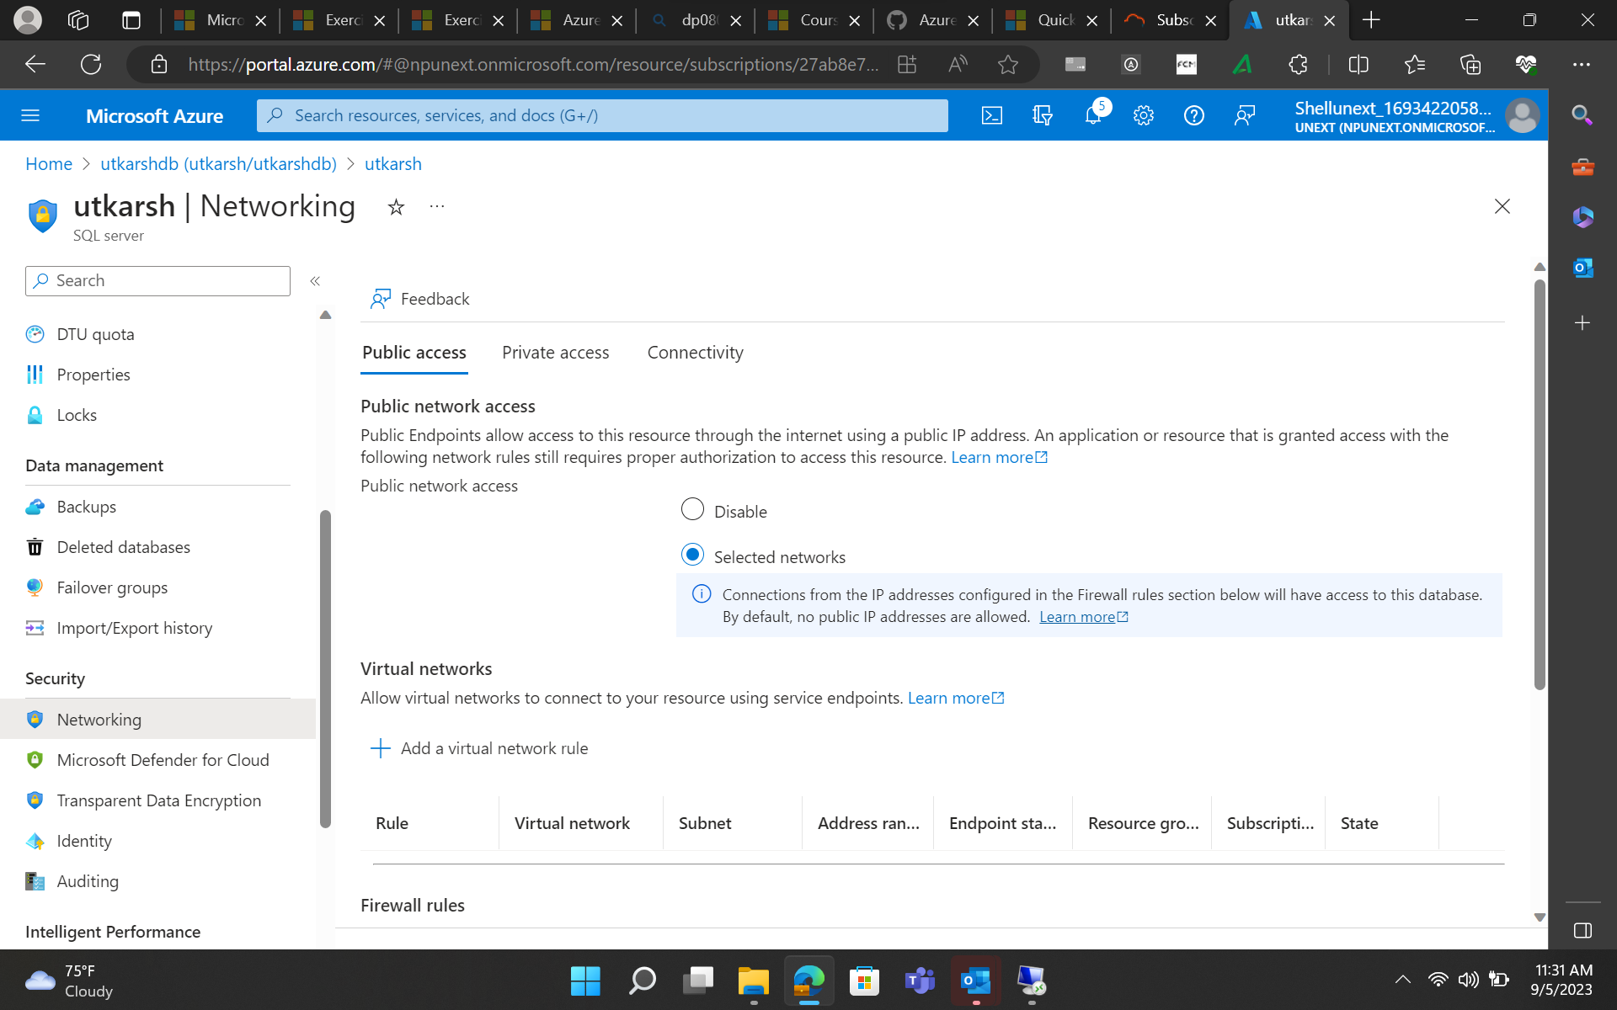

Slide 23
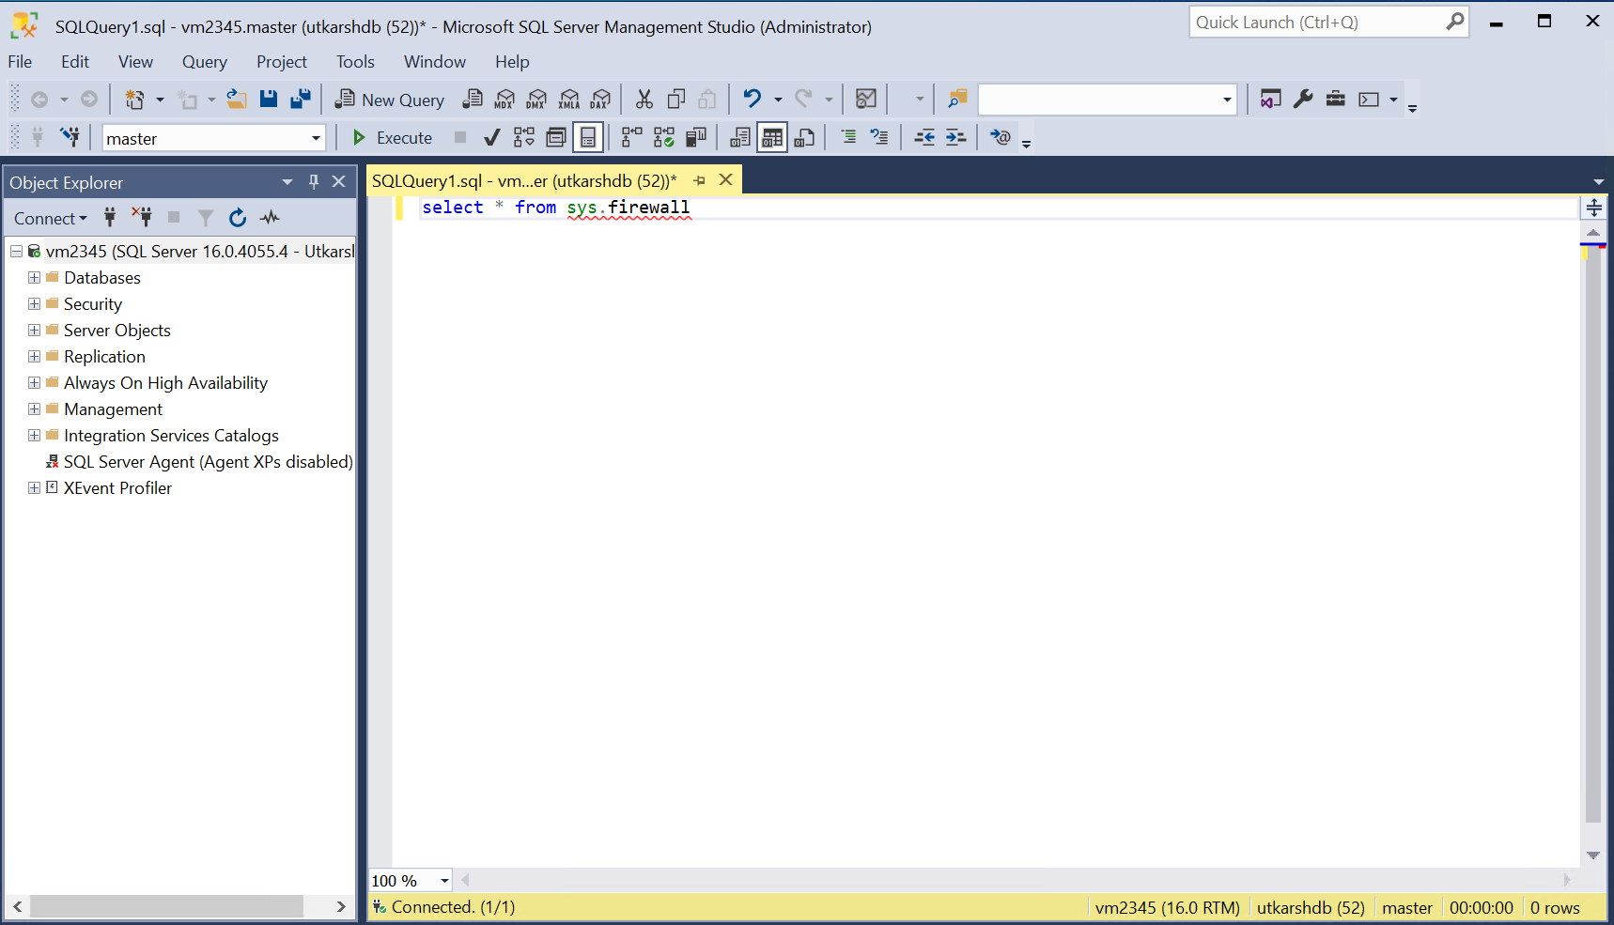

Slide 24
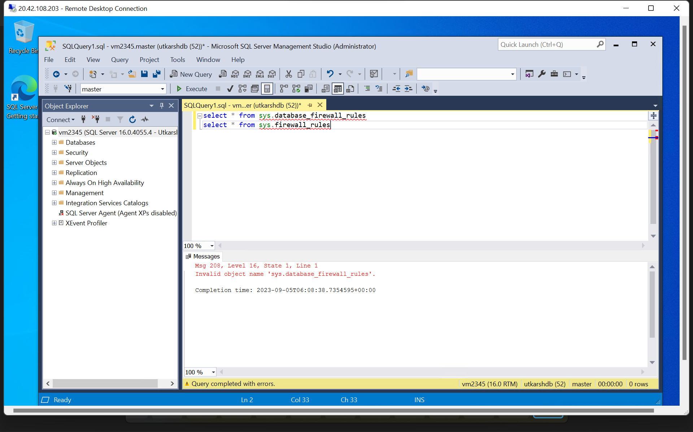

Slide 25
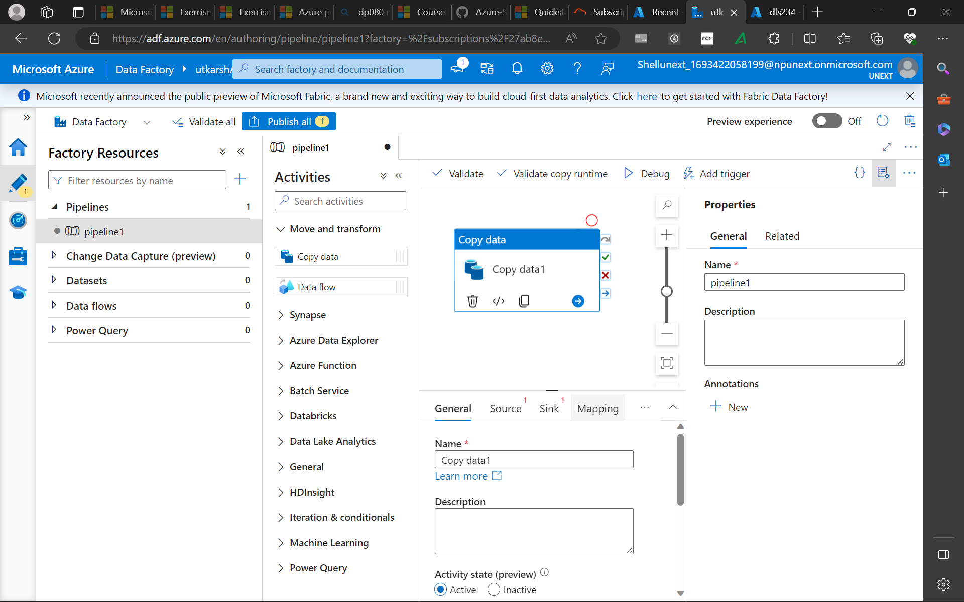

Slide 26
Wednesday
Ingesting and transforming data
Self Hosted Integration Runtime
Lookup and Get Metadata activities

Slide 27
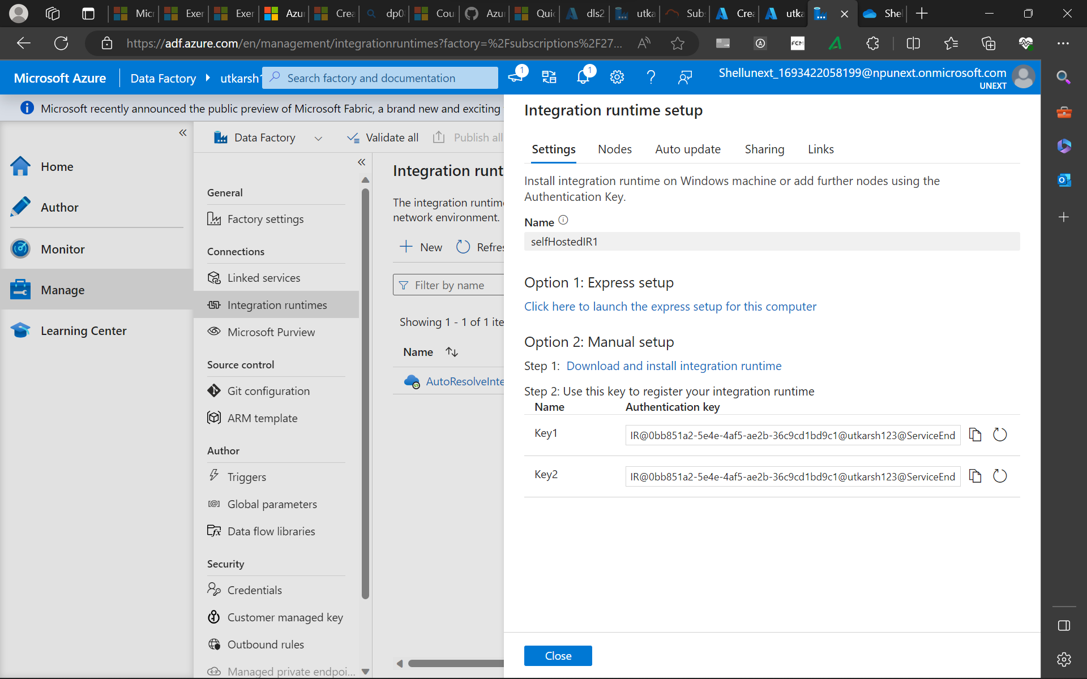

Slide 28
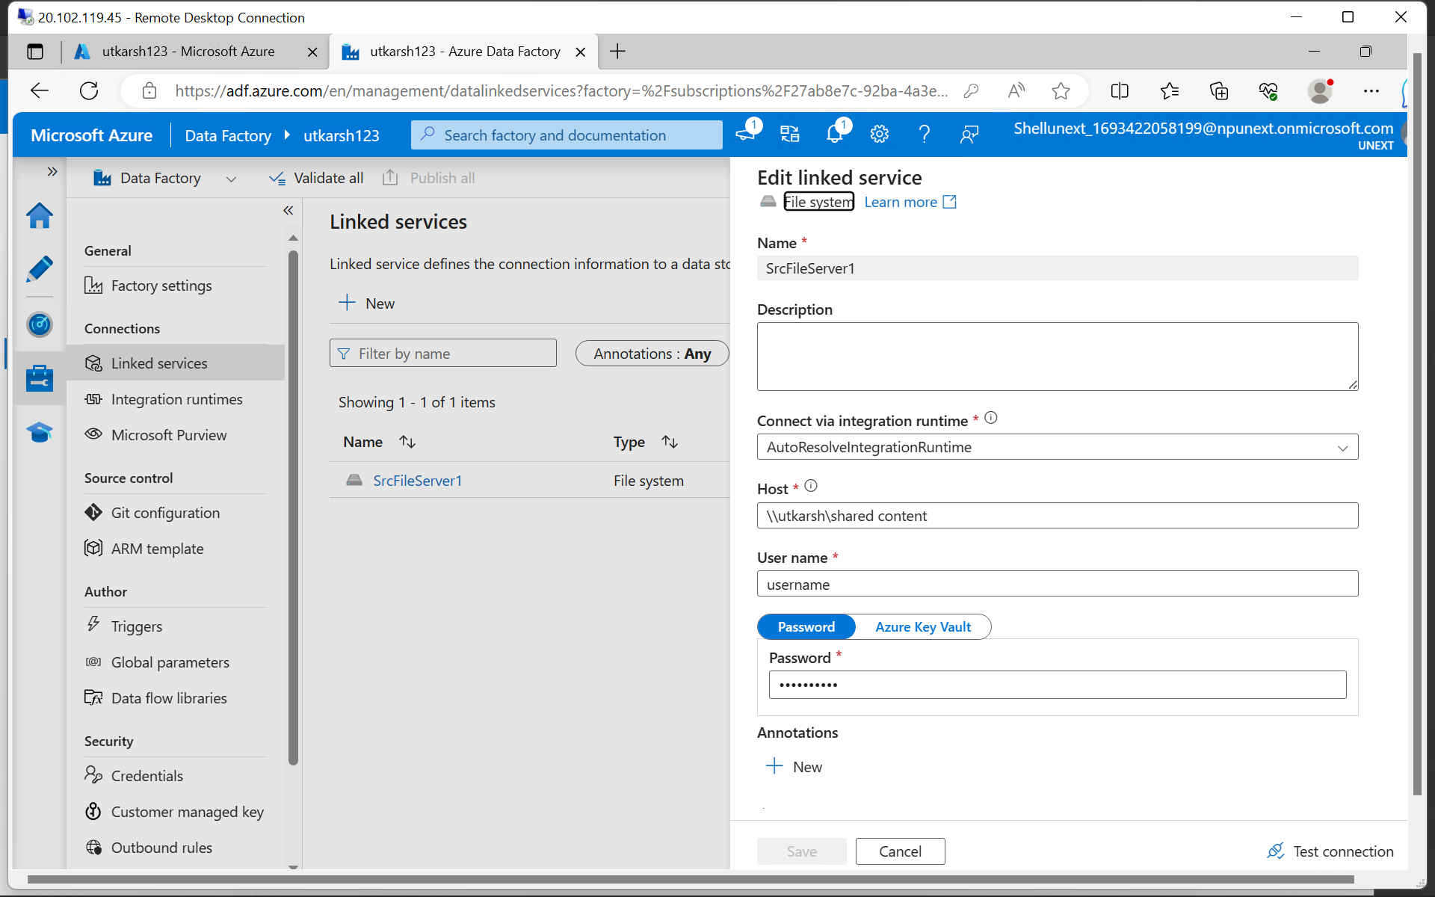

Slide 29
Thursday
Filter, For Each, If Else activities
Data flow: source, sink, transformations(conditional split, derived columns)

Slide 30
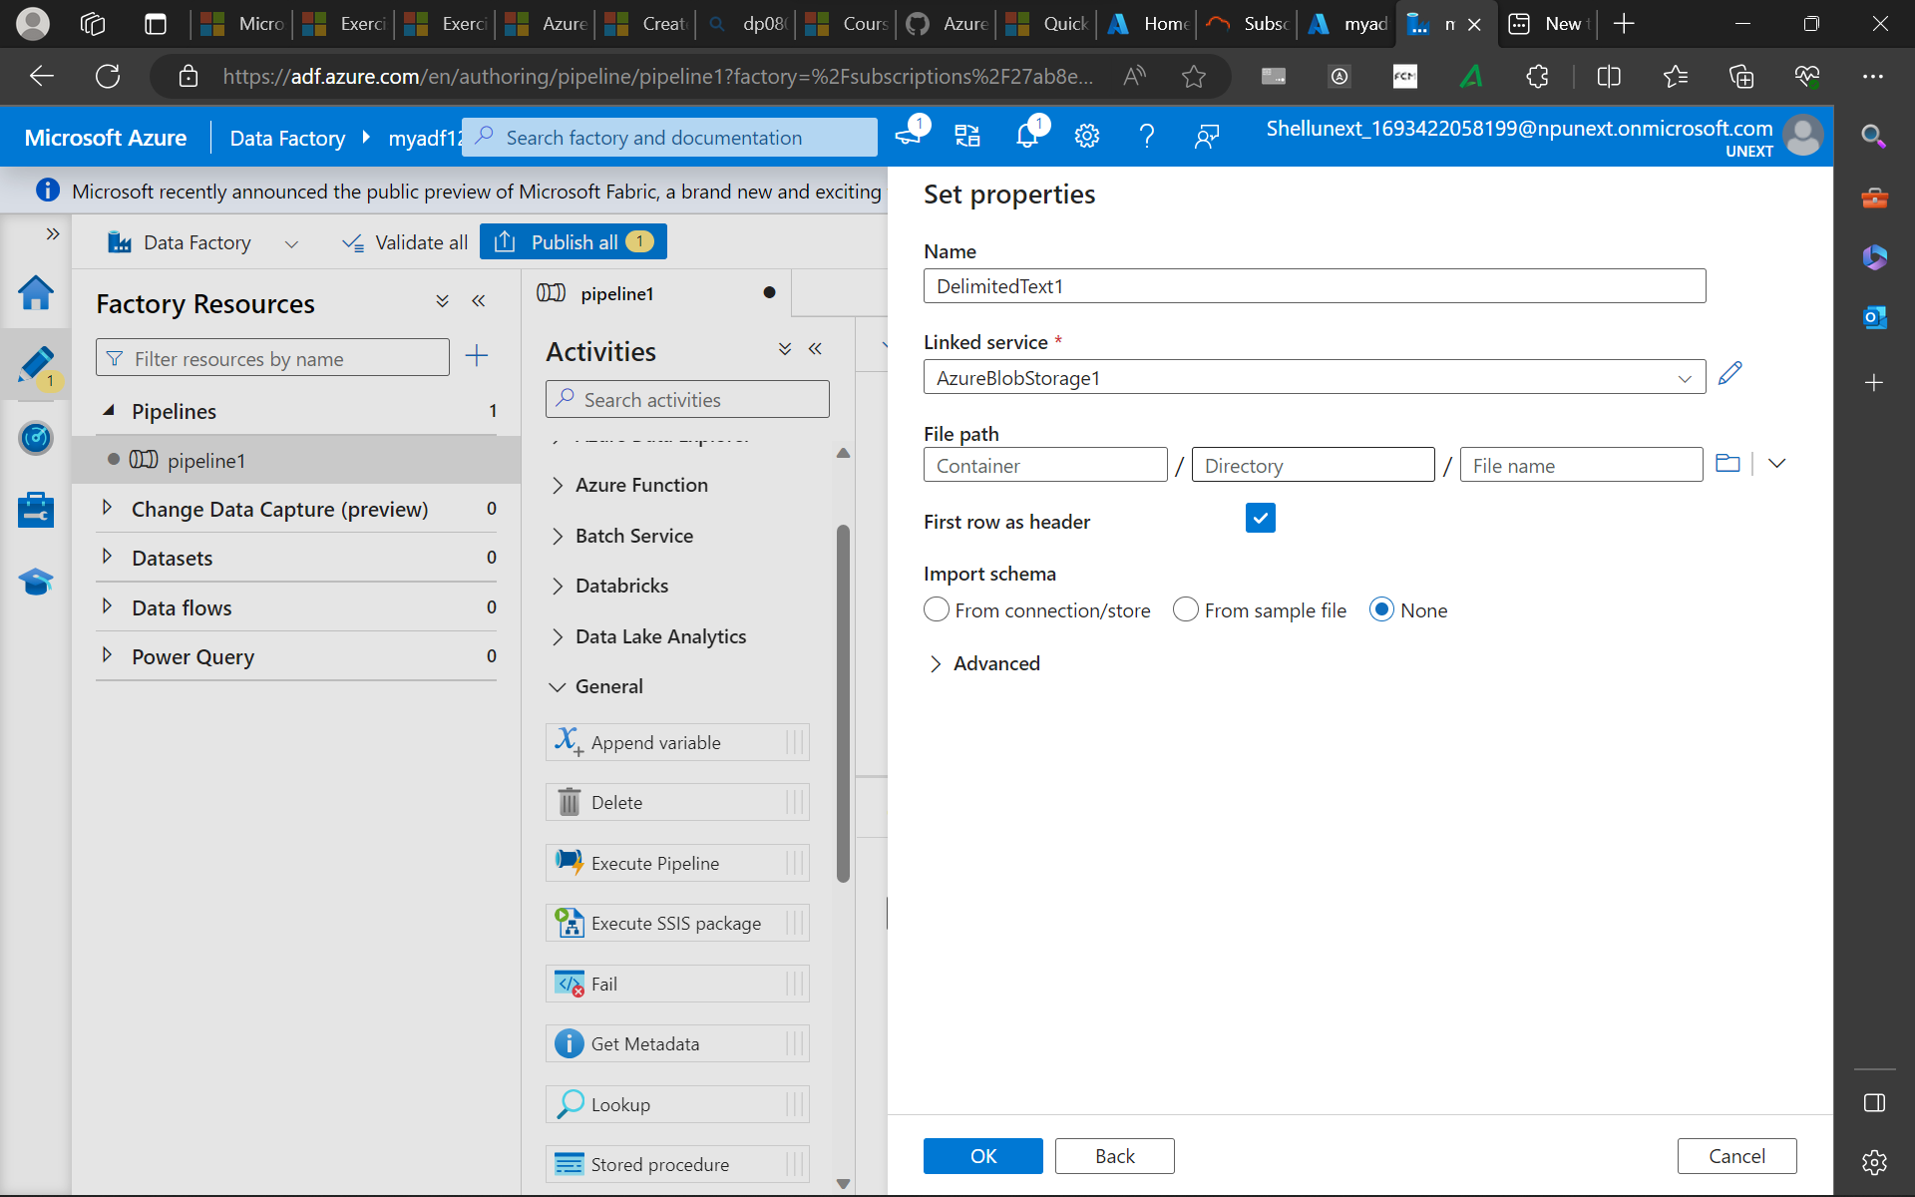

Slide 31
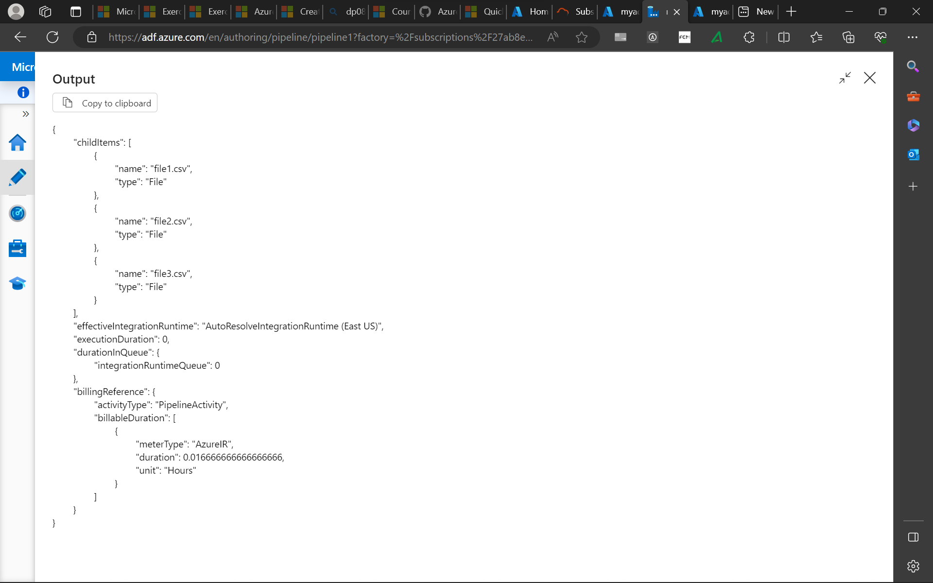

Slide 32
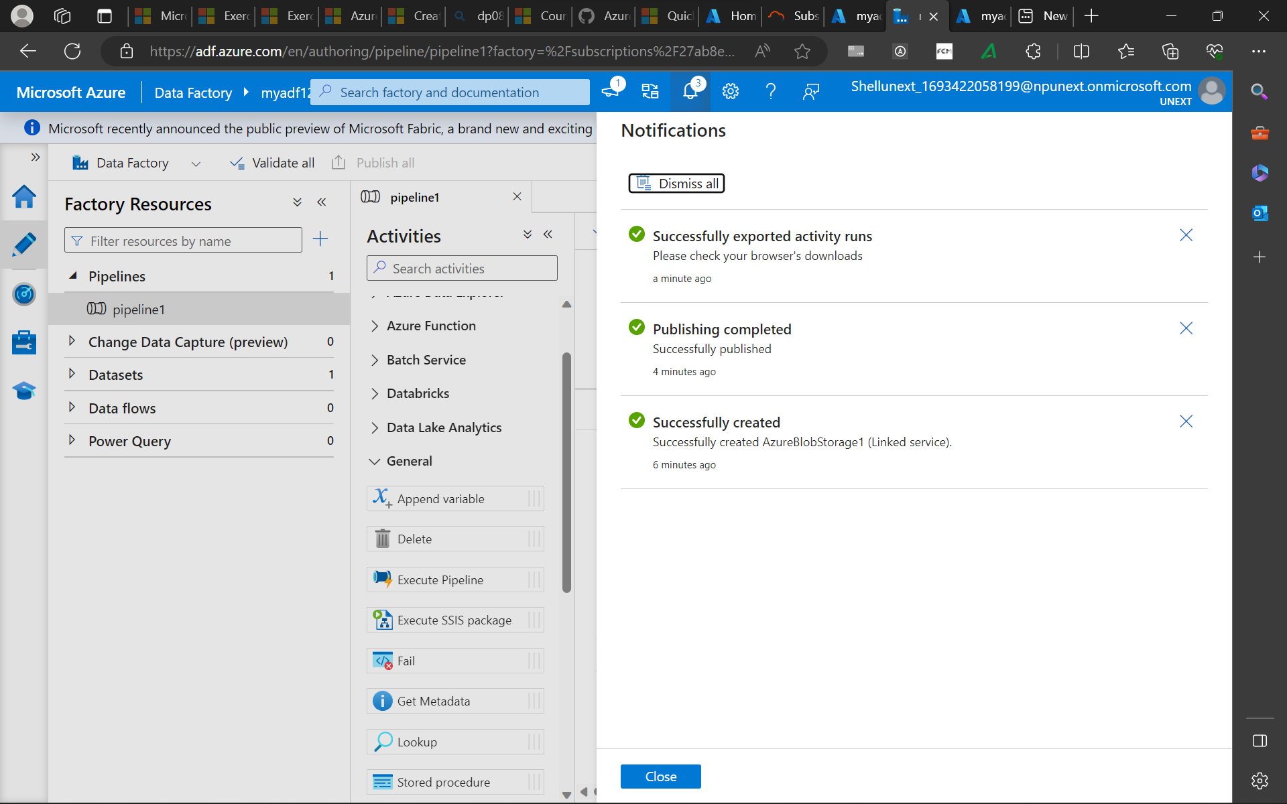

Slide 33
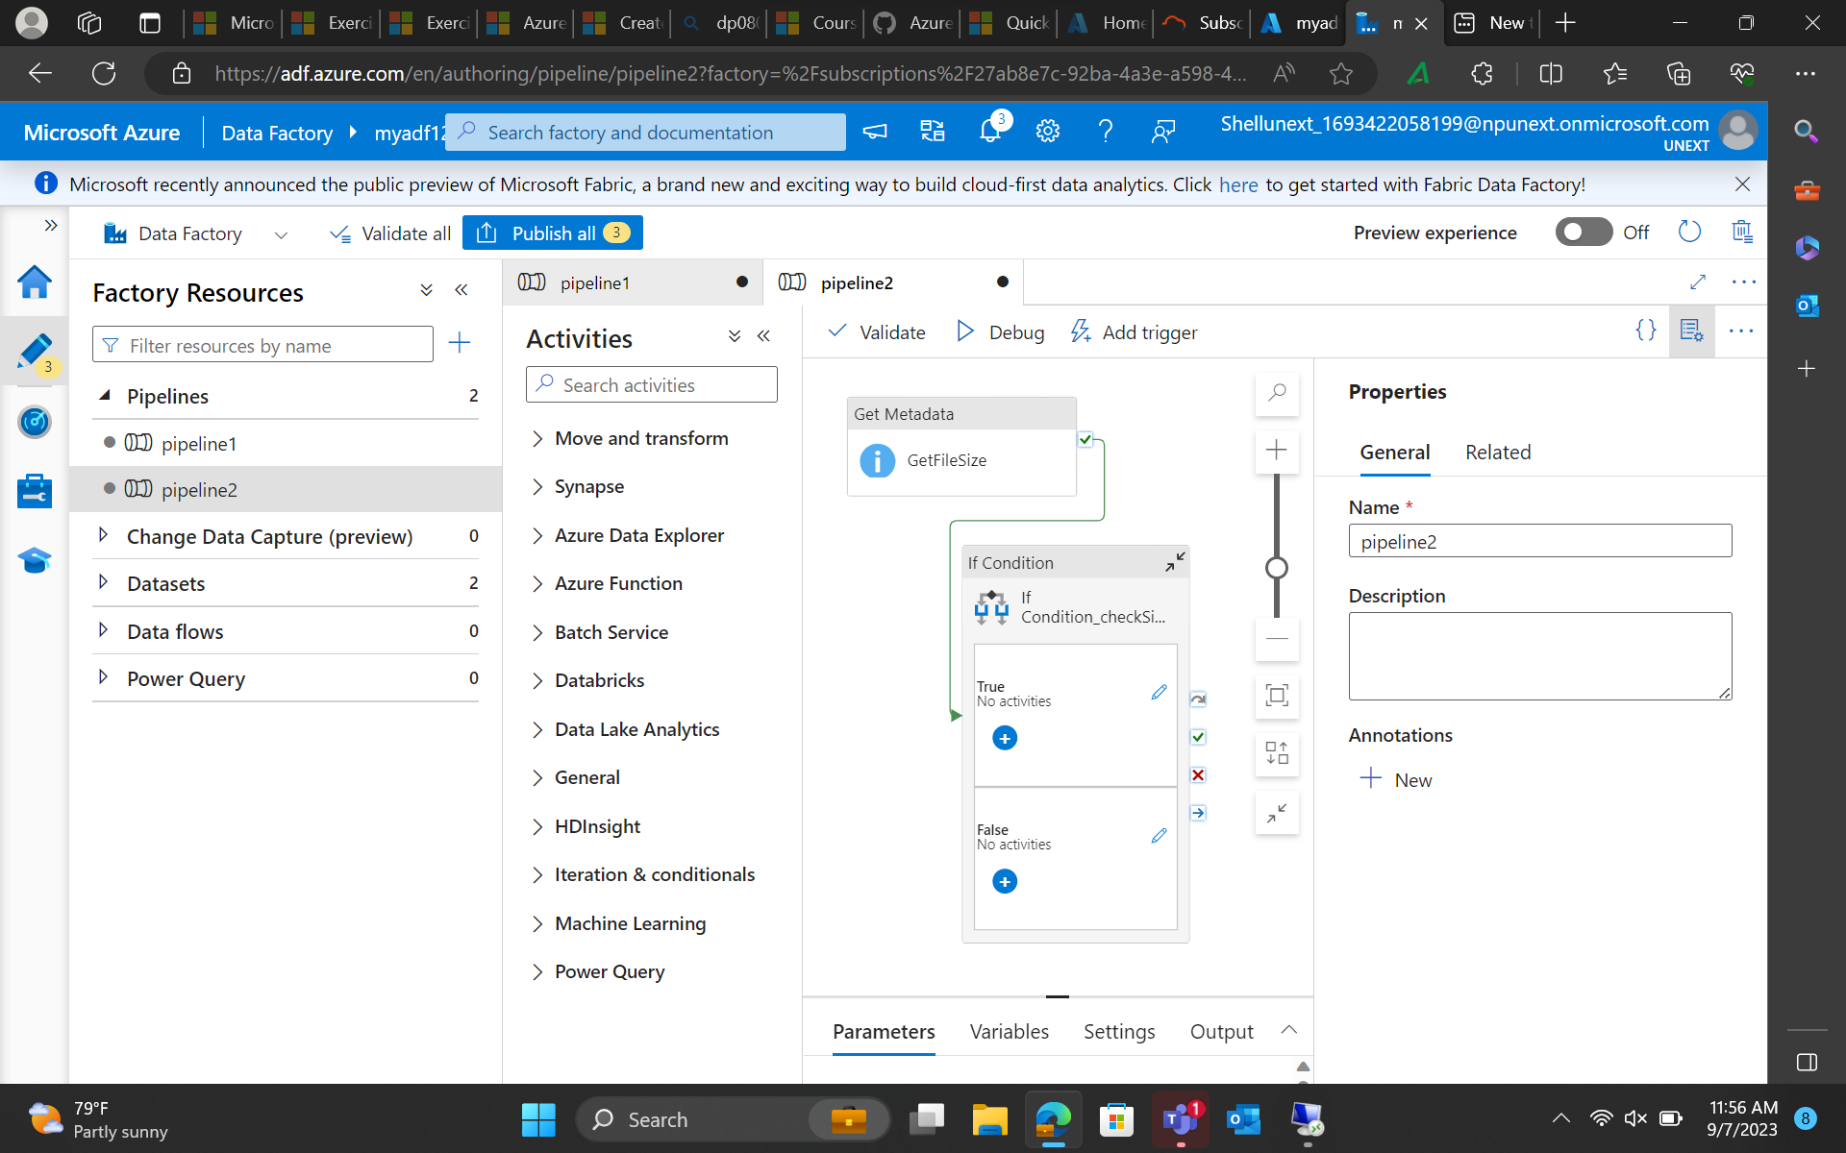

Slide 34
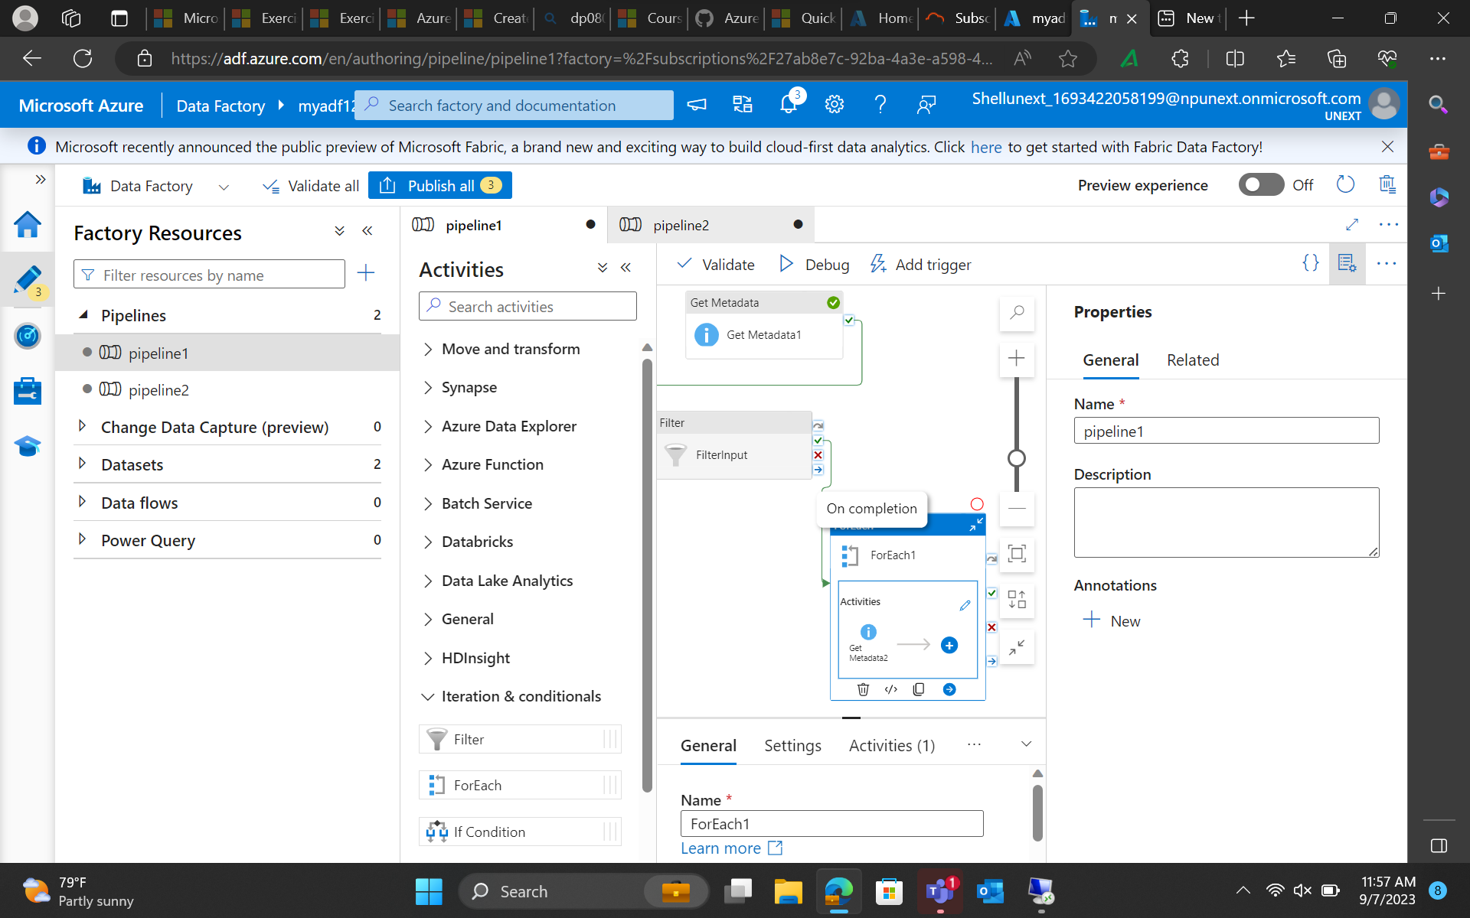

Slide 35
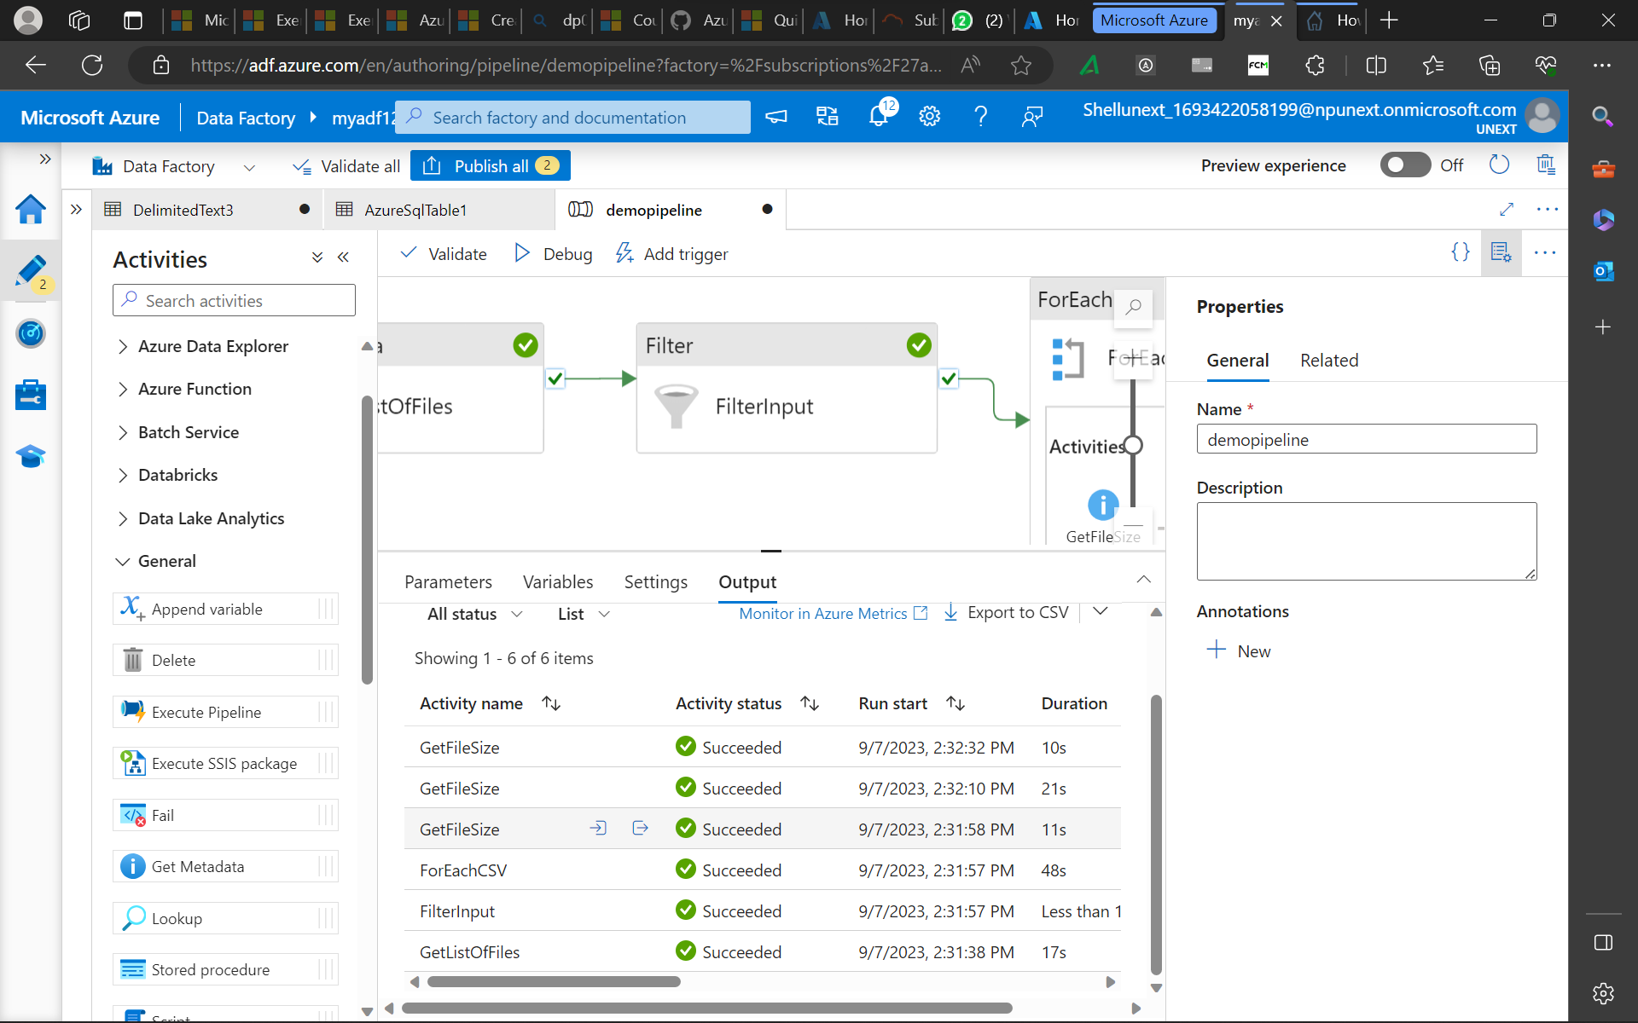

Slide 36
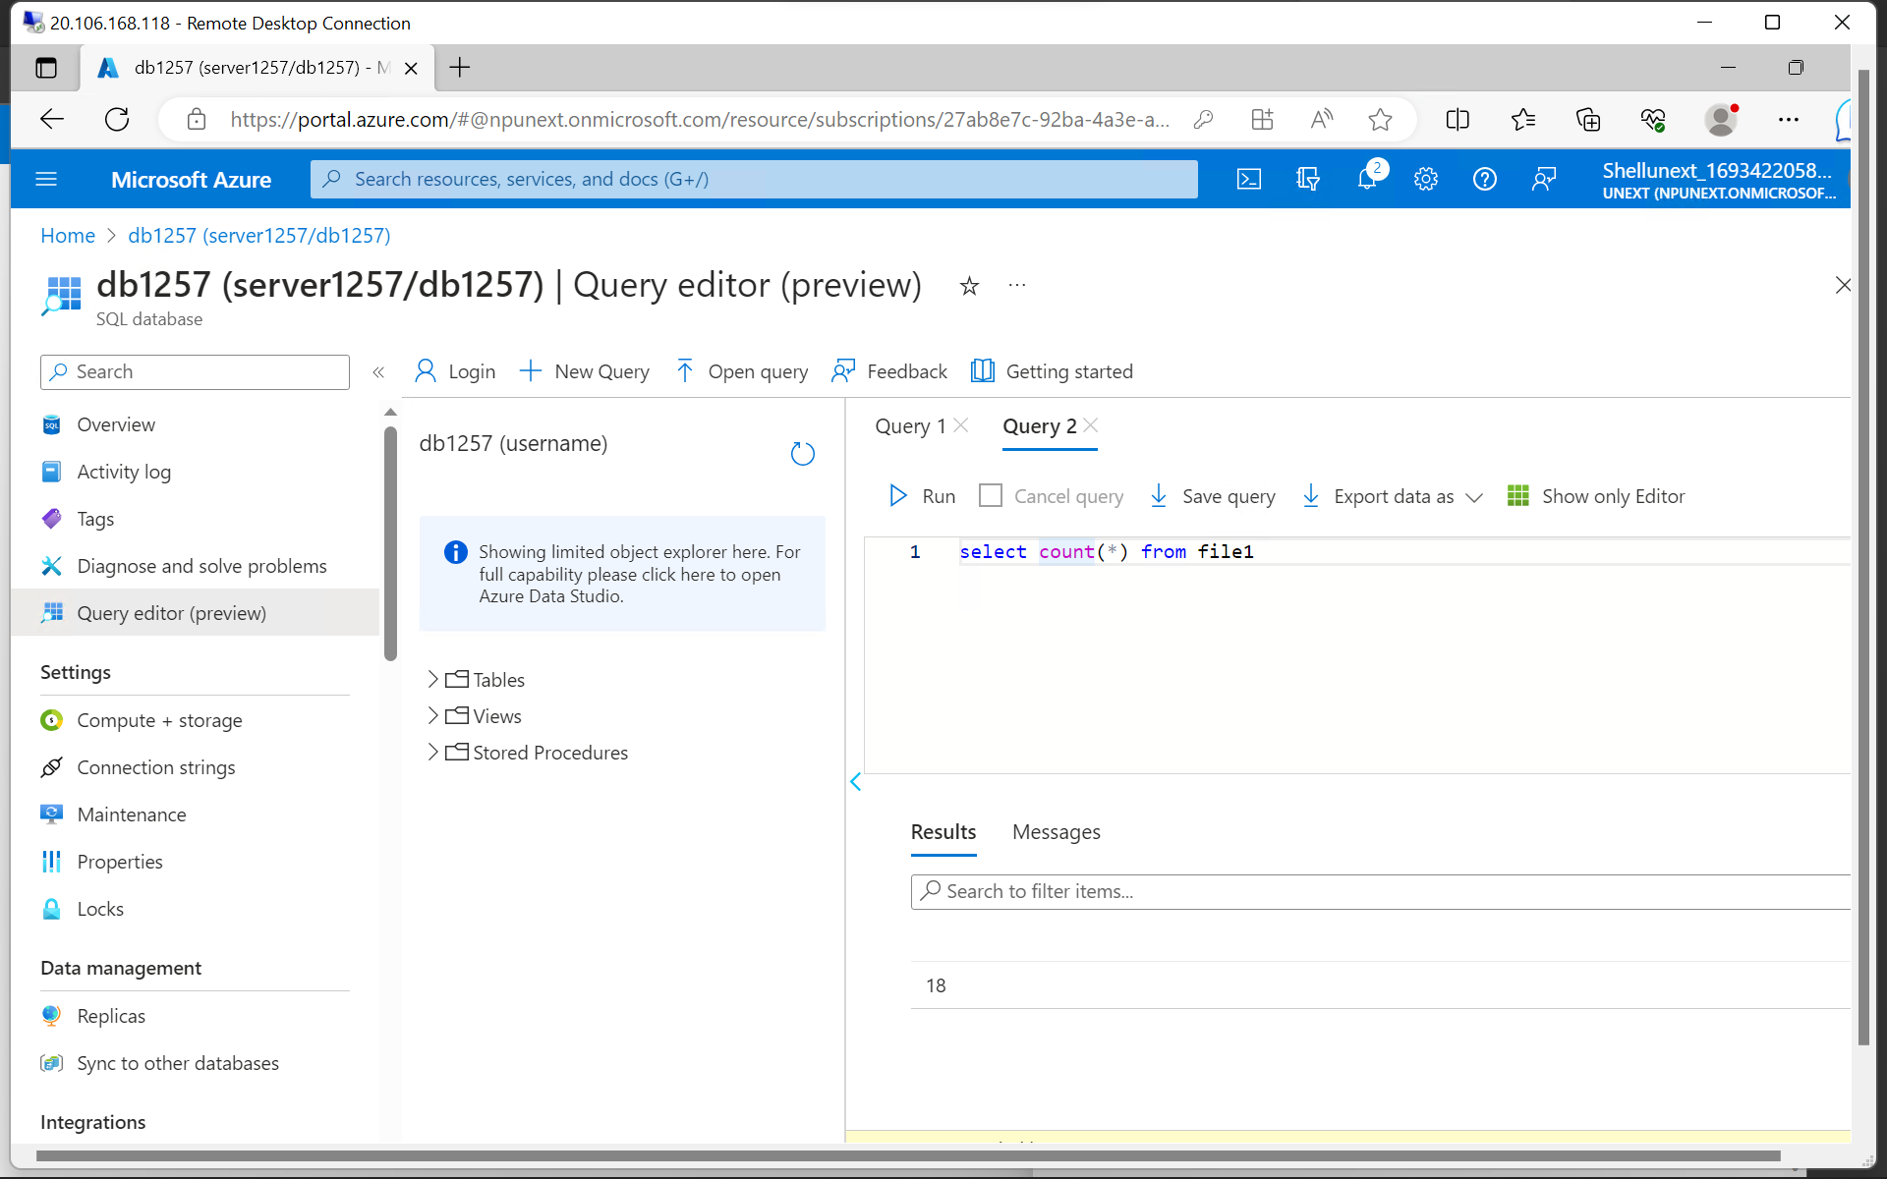

Slide 37
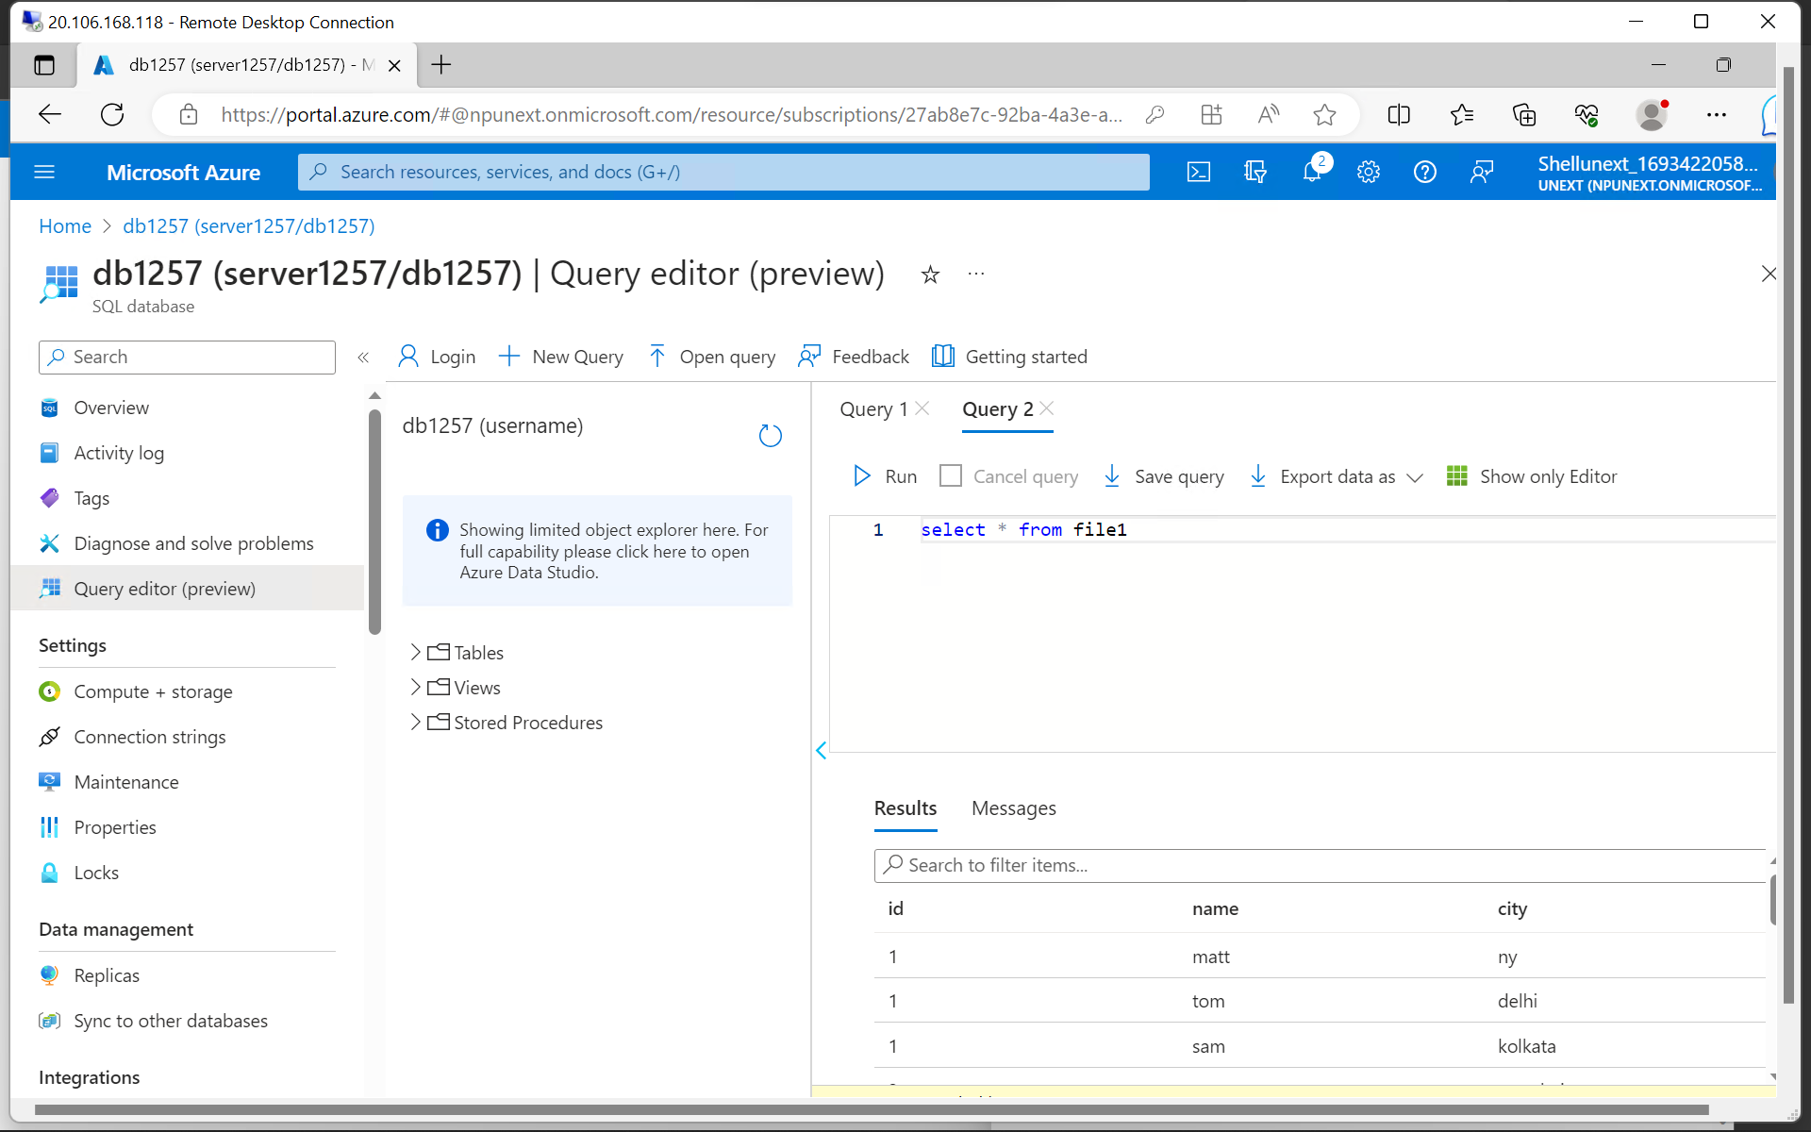

Slide 38
Friday
Data flow case study
API Integration
Change Data Capture
Azure Monitor

Slide 39
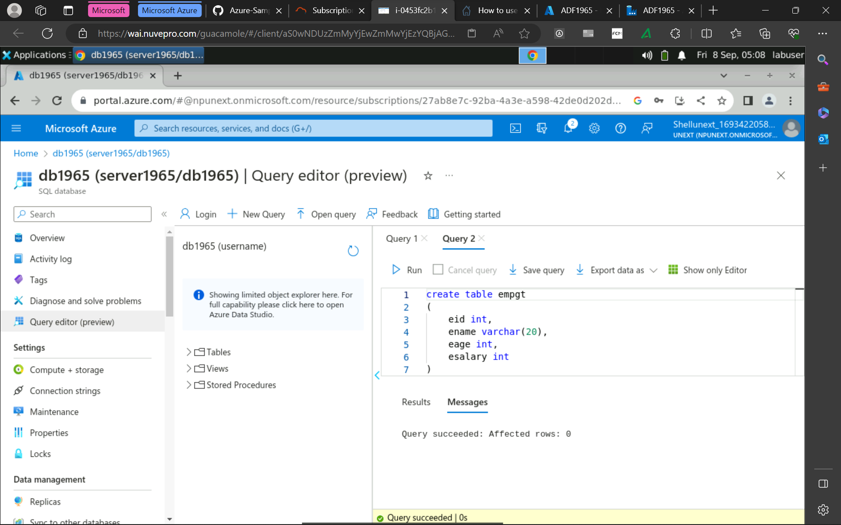

Slide 40
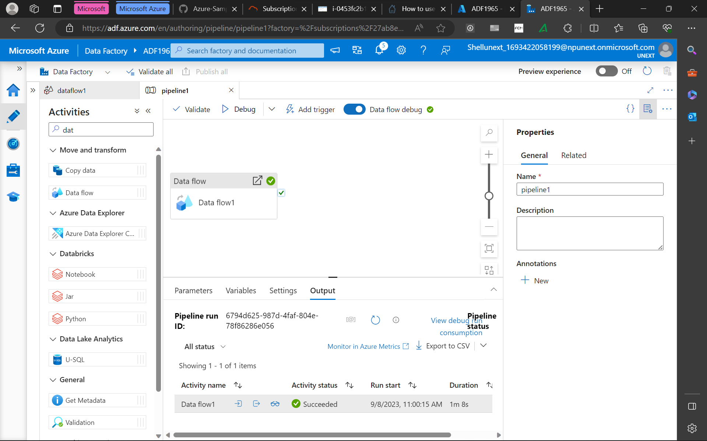

Slide 41
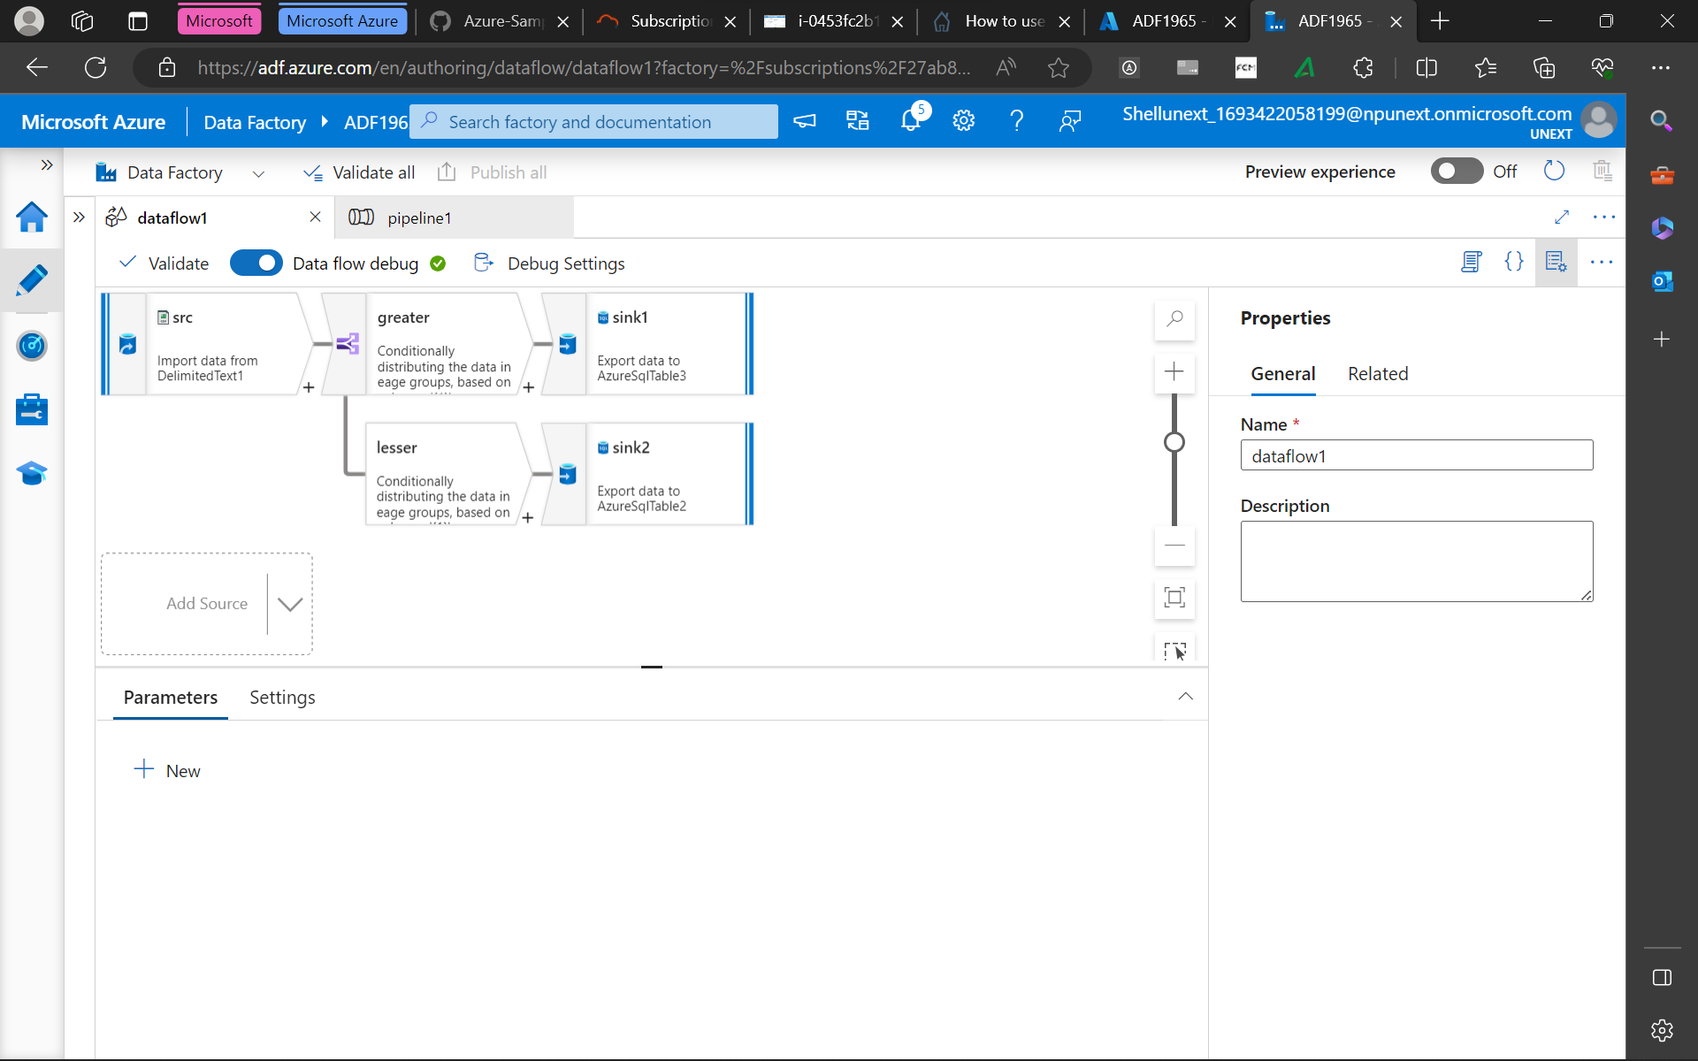

Slide 42
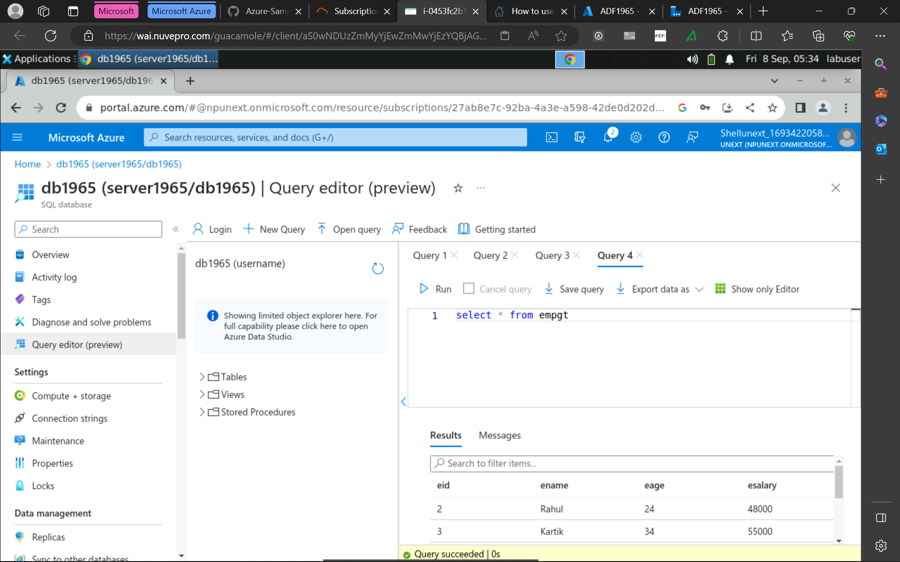

Slide 43
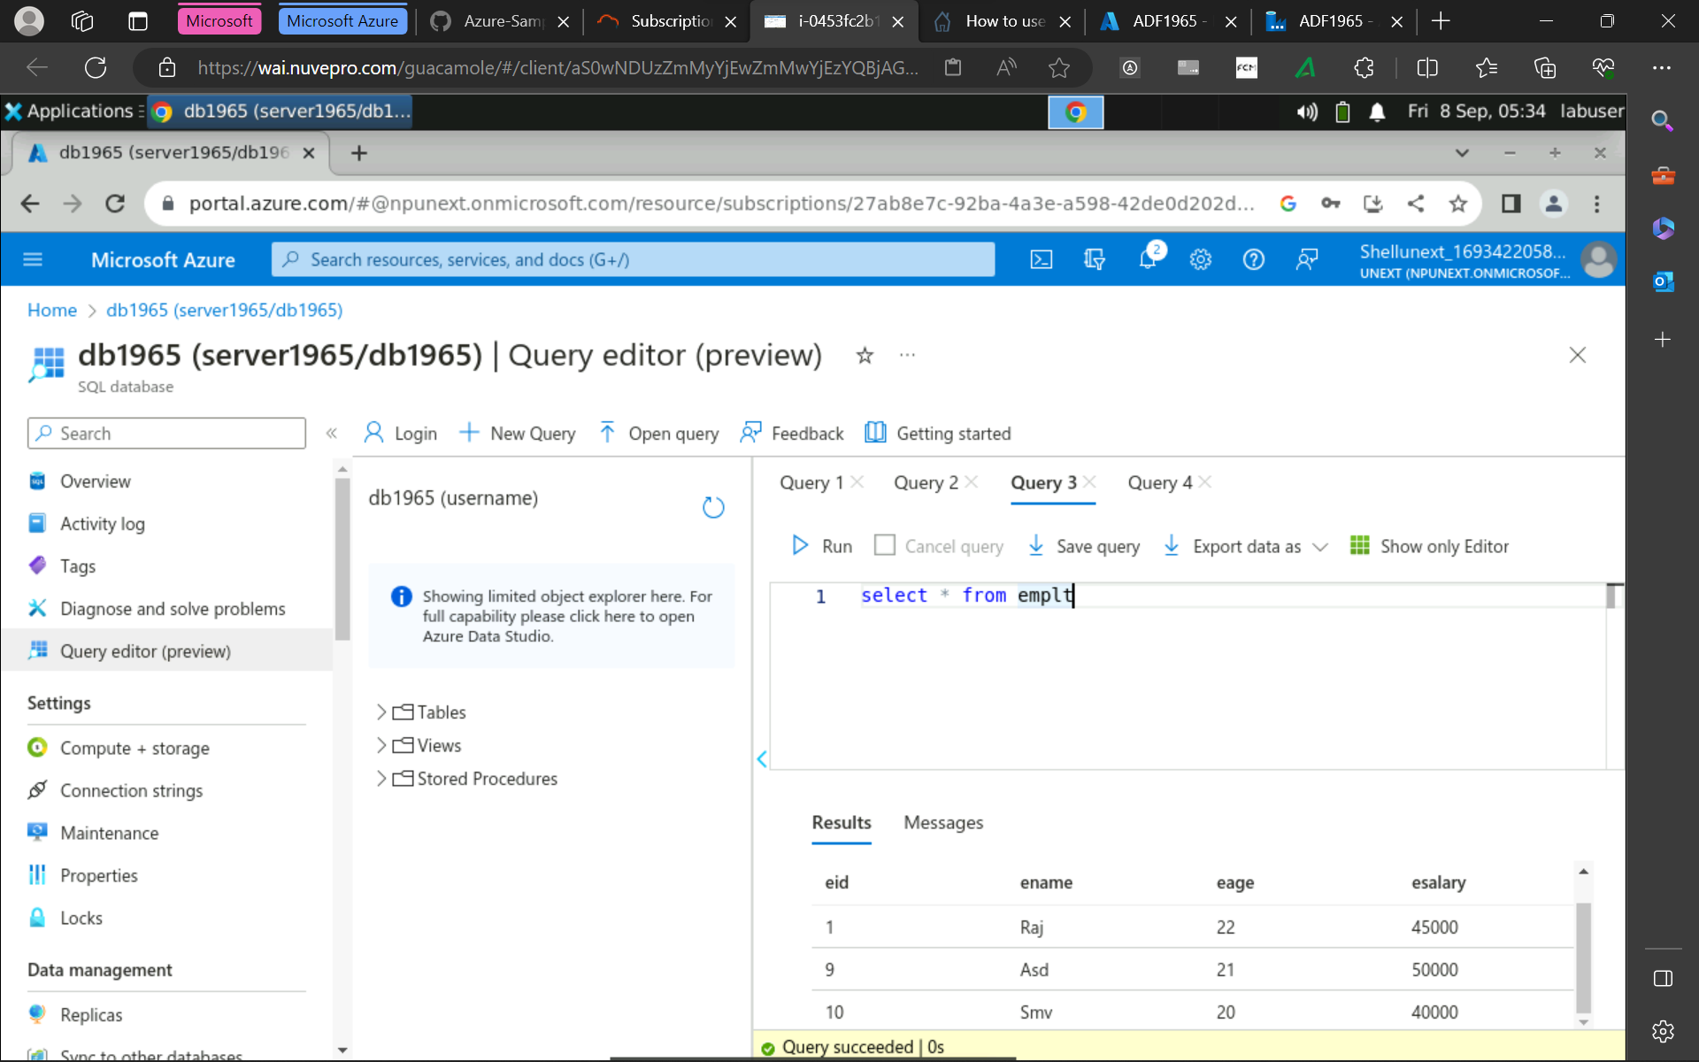

Slide 44
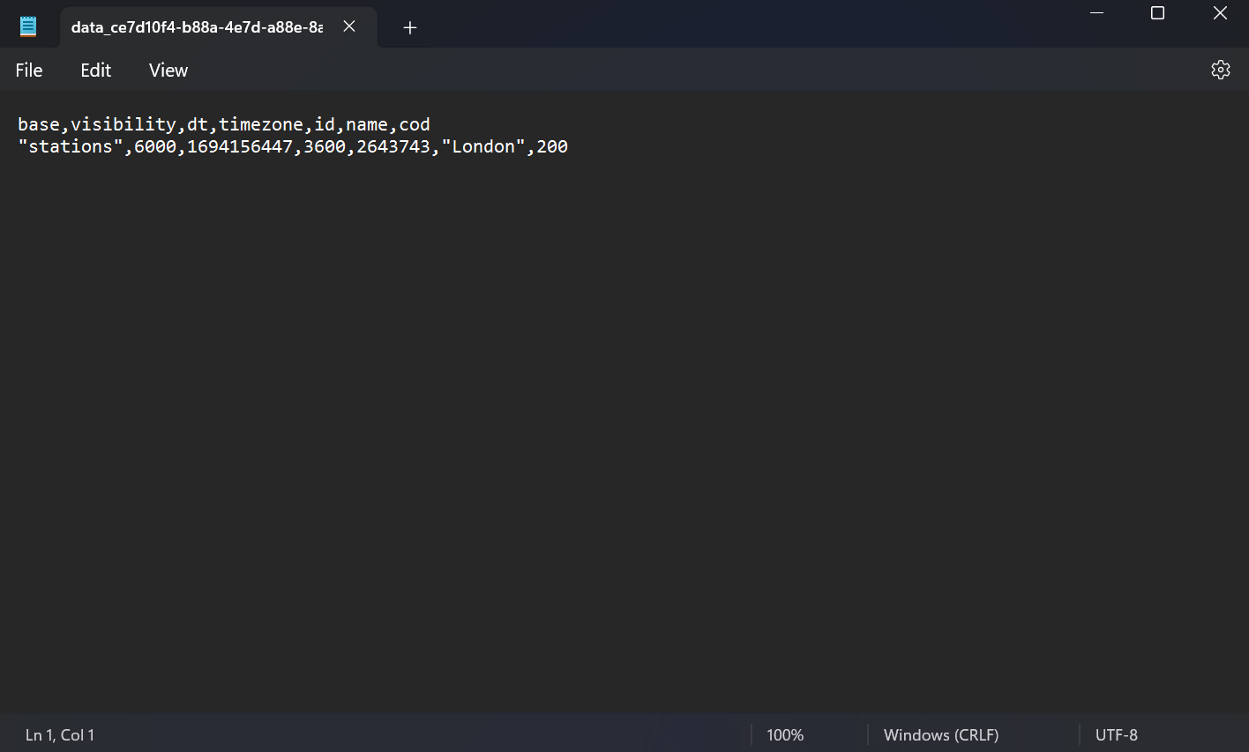

Slide 45
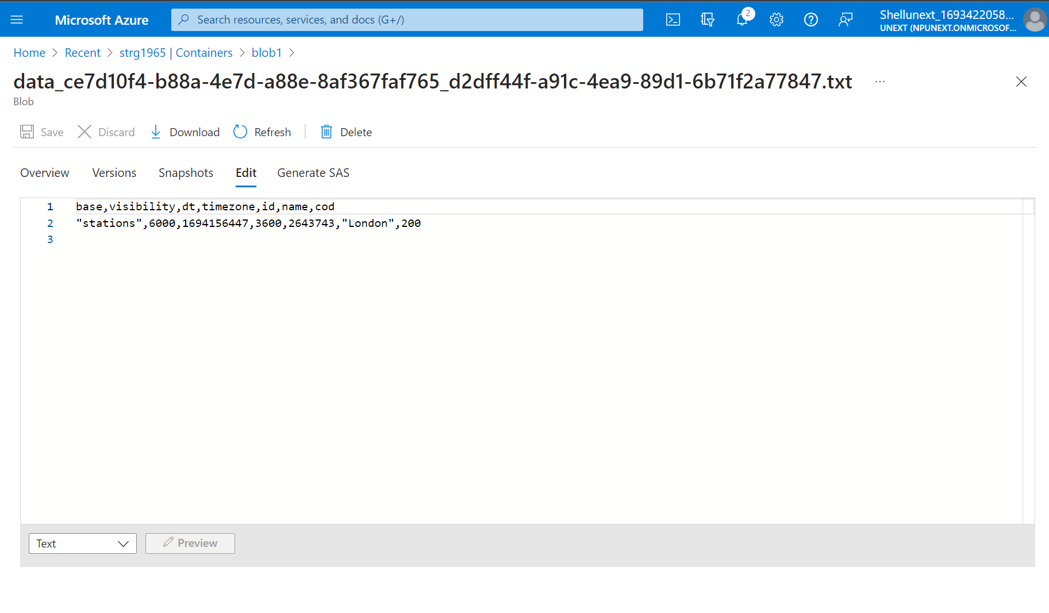

Slide 46
